Slide 2
6.3 page 117

Slide 3
Romanesque churches are typified by the cross-form of the ground plan, as well as a variety of structural forms, the great number of towers and with elements of fortification.

Slide 4
During the medieval period most people worshiped in small churches near their homes. Larger churches called cathedrals were built in city areas.
stone ceilings
was very heavy
weight of the ceilings would tend to buckle the walls outward
large piles of stone would be stacked along the wall in intervals to buttress

Slide 5
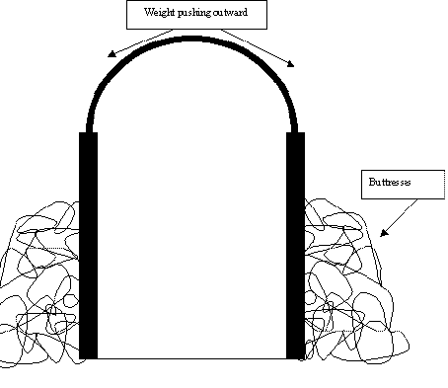
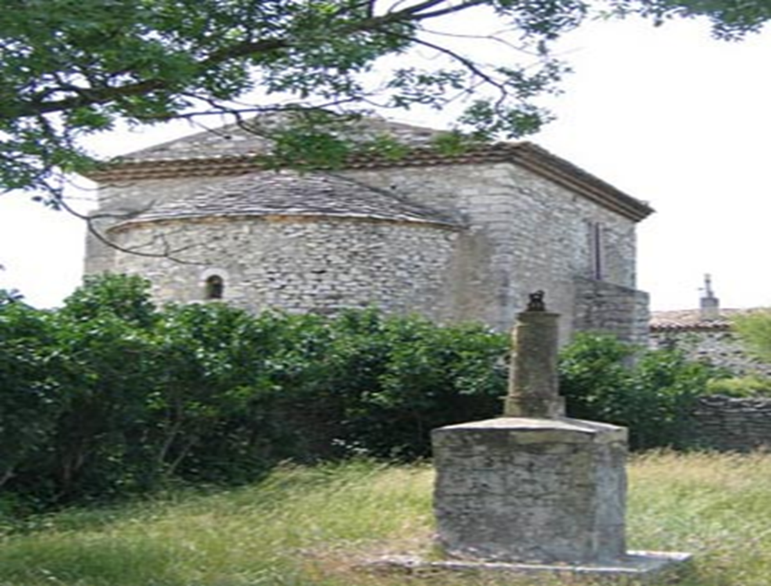
Barrel Vault

Slide 6
Before the invention of the Gothic flying buttress, medieval churches had very thick walls and few windows. This style was called Romanesque.
A new spirit in the church and access to more money from the growing wealth of towns and from trade helped fuel the building of churches in several European countries. In the early 1100's, a new style of architecture, known as Gothic, evolved throughout medieval Europe.

Slide 7
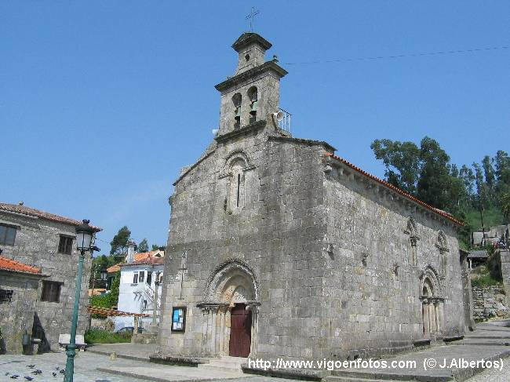
Romanesque

Slide 8
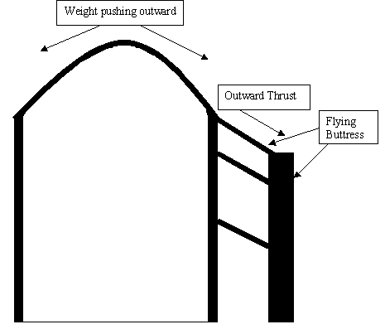
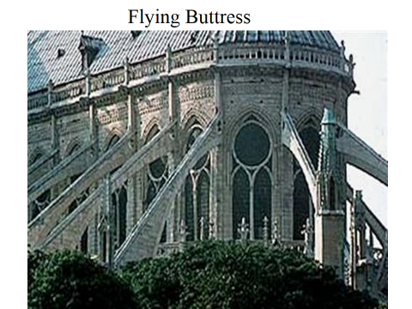

Slide 9
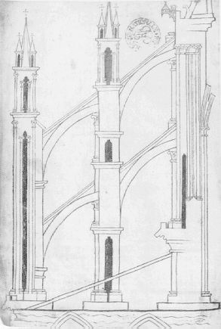

Slide 10
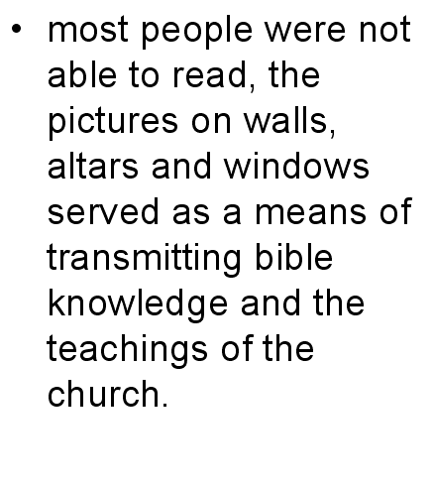

Slide 11
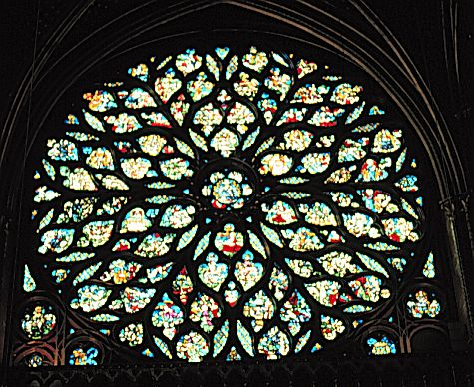

Slide 12
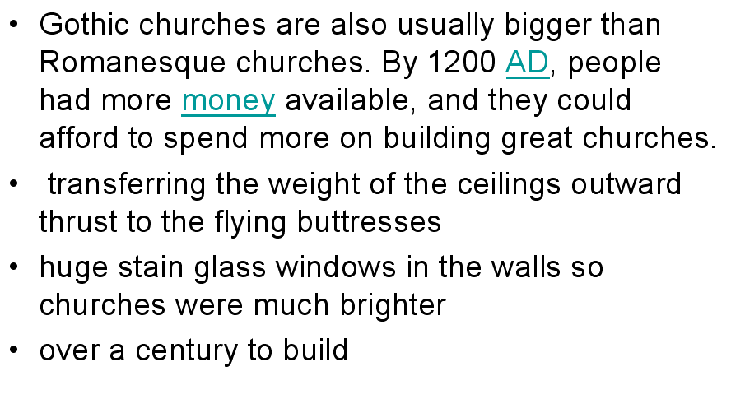

Slide 13
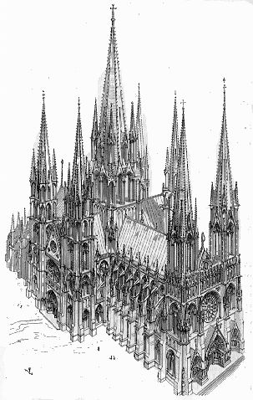

Slide 14
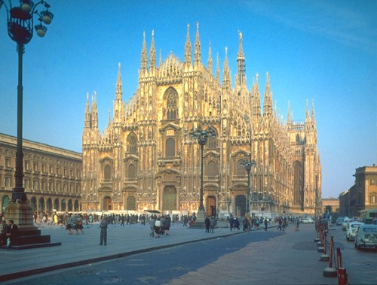

Slide 15
The term Gothic comes from a Germanic tribe named the Goths. Unlike the heavy, gloomy Romanesque buildings, Gothic cathedrals thrust upward as if reaching toward heaven. Light streamed in through huge stained glass windows.
Other arts of the medieval world were evident around or in the Gothic cathedral-sculpture, wood-carvings, and stained glass windows. All of these elements were meant to inspire the worshiper with the magnificence of God.

Slide 16
Kings, Popes and Princes thought it honorable to found new universities. By 1500 there were 80 universities in Europe. Students began their studies with a liberal arts course of study. When this was completed they could go on to study law, medicine, or theology. Theology is the study of God and religion. (10 years) If they passed their exams (all given at very end) they were awarded doctor's degree.

Slide 17
Scholasticism-the attempt to reconcile faith and reason, ie)harmonize Christian teachings with the works of Greek philosophers. Aristotle had reached his many conclusions by rational thought not by faith. Some of his ideas contradicted teachings of the church.
In the mid-1200's, the scholar Thomas Aquinas argued that the most basic religious truths could be proved by logical argument.

Slide 18
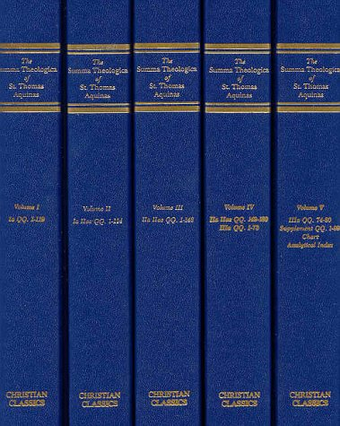
Between 1267 and 1273, Aquinas wrote the Summa Theologicae. Aquinas' great work, influenced by Aristotle, combined ancient Greek thought with the Christian thought of his time.
St. Thomas Aquinas attempted to reconcile Aristotle's teachings with the doctrines of Christianity.

Slide 19
New ideas and forms of expression began to flow out of the universities. At a time when serious scholars and writers were writing in Latin, a few remarkable poets began using a lively vernacular. Vernacular literature was literature written in the language of everyday speech in a particular region.
Some of these writers wrote masterpieces that are still read today.
Since most people couldn't read or understand Latin, these works written in the vernacular brought literature to many people.

Slide 20
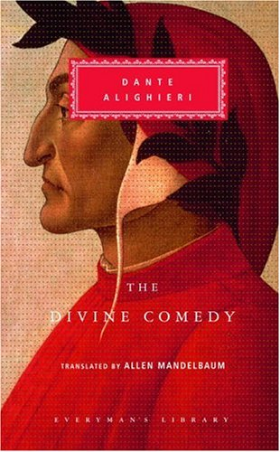
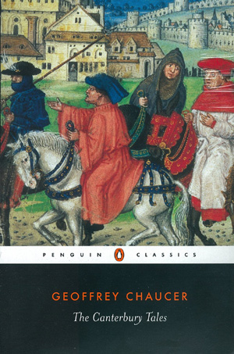
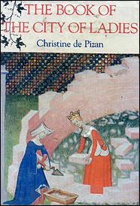
Written in Italian
Written in English
Written in French

Slide 21
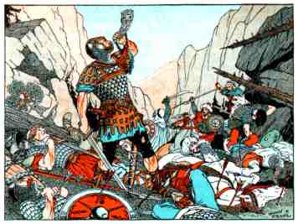
Chanson de geste is another form of vernacular literature, it described battles in which knights fight courageously for their kings and lords. Written in epic poem form.

Slide 22
Section 3 Review
1. What is the type of literature written in the language of everyday speech in a particular region?
2. Who attempted to reconcile Aristotle's teachings with the doctrines of Christianity?
3. What are the elements of Romanesque and Gothic medieval churches? Compare and Contrast.

Slide 23
Review Continued
4. Why did the walls of Romanesque Churches have to be so thick?
5. Why were the Gothic Churches able to have large stain glass windows? What purpose did they serve?
6. What is a buttress? How is it different from a flying buttress?

