Slide 2
Section 4 The Black Death 3 min
http://www.youtube.com/watch?v=ldZjaT4WXrA&safe=active

Slide 3
During the 1300's, an epidemic struck parts of Asia, North Africa, and Europe. Approximately one-third of the population of Europe died of the deadly disease known as the bubonic plague.
Unlike catastrophes that pull communities together, this epidemic was so terrifying that it ripped apart the very fabric of society.

Slide 4
Black Death
Bubonic plague is the medical term
an organism, most usually carried by rodents.
the flea regurgitates the blood from the rat into the human, infecting the human. The rat dies, the human dies.
symptoms include high fevers and aching limbs and vomiting blood.

Slide 5
Most characteristic is a swelling of the lymph nodes.
neck, armpits, and groin
swelling protrudes and is easily visible, its blackish coloring gives the disease its name, the Black Death
swellings continue to expand until they eventually burst, with death following soon after
whole process, lasts only three or four days
swiftness of the disease, the terrible pain, the grotesque appearance of the victims, all served to make the plague especially terrifying.

Slide 6
Could you prevent it?? Do you really think this will work?
incense: juniper, laurel, pine, beech, lemon leaves, rosemary, camphor, sulphur and others.
cure of sound was another remedy. Towns rang church bells to drive the plague away
talismans, charms and spells could be purchased.

Slide 7
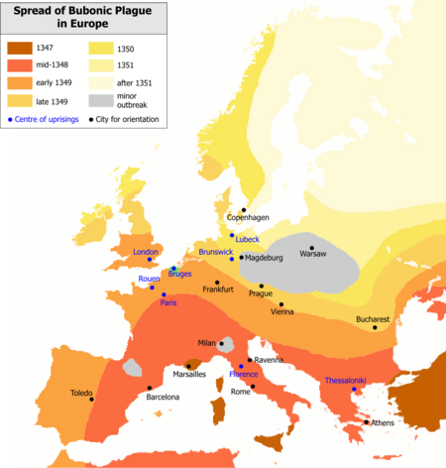

Slide 8
What caused it?
conjunction of Saturn, Jupiter, and Mars in the sign of Aquarius that had occurred in 1345. This conjunction cause hot moist conditions, which cause the earth to exhale poisonous vapors. This is what the Pope's experts said.
Educated men said- have no bad thoughts, only those that please you to ward off the sickness.

Slide 9
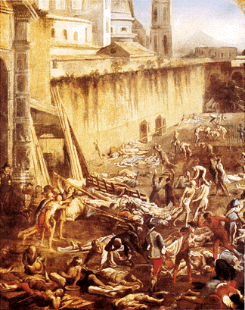

Slide 10
How really to avoid the illness.
Quarantine
The wealthy would flee to the countryside
The plague bacillus actually is destroyed by heat
overall population loss in Europe at about 1/3

Slide 11
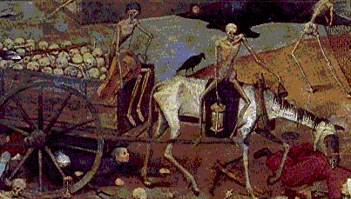
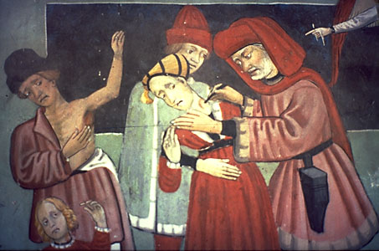

Slide 12
The economic and social effects of the plague were enormous. The old manorial system began to crumble. Some of the changes that occurred included:
Town populations fell
Trade declined. Prices rose.
The serfs left the manor in search of better wages
Nobles fiercely resisted peasant demands for higher wages, causing peasant revolts in England, France, Italy, and Belgium

Slide 13
Jews were blamed for bringing on the plague. All over Europe, Jews were driven from their homes or, worse, massacred
This Anti-Semestism (hostility towards the Jews) in Medieval Europe was partly caused by the bubonic plague.
The Church suffered a loss of prestige when its prayers failed to stop the onslaught of the bubonic plague and priests abandoned their duties.

Slide 14
http://www.youtube.com/watch?v=KFaZT1nrSc8&safe=active
45 min Black Death

Slide 15
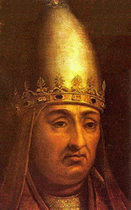
In 1300, Pope Boniface VIII attempted to enforce papal authority on kings as previous popes had. When King Philip IV of France asserted his authority over French bishops. Boniface responded with an official document. It stated that kings must always obey popes.

Slide 16
Philip ignored the Pope's statement. One of Philip's ministers said to have stated that "my master's sword is made of steel, the pope's is made of words."
Instead of obeying the pope, Philip had him held prisoner in September 1303. The king planned to bring him to France for trial. The pope was rescued, but the elderly Boniface died a month later.
Never again would a pope be able to force monarchs to obey him.

Slide 17
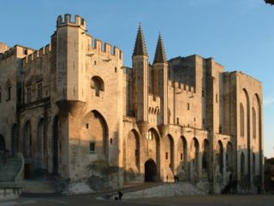
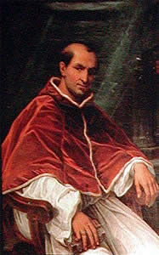
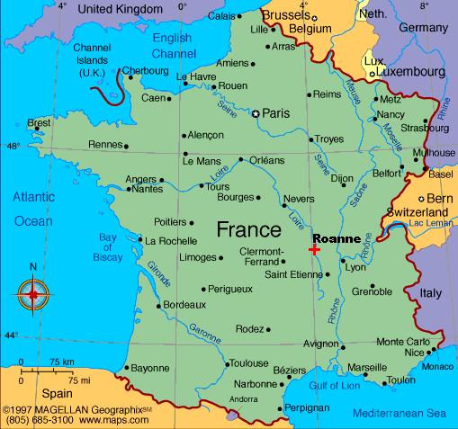
In 1305, Philip IV, persuaded the College of Cardinals to choose a French archbishop as the new pope. Clement V, the newly selected pope, moved from Rome to the city of Avignon in France. Popes would live there for the next 69 years.
Palais Des Papas

Slide 18
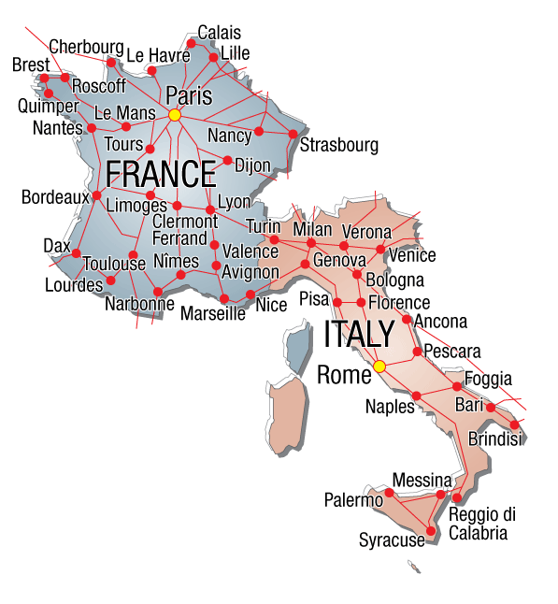
The move to Avignon badly weakened the Church. When reformers finally tried to move the papacy back to Rome, however, the result was even worse.

Slide 19
In 1378, Pope Gregory XI died while visiting Rome. The College of Cardinals then met in Rome to choose a successor. As the deliberated, they could hear a mob outside screaming, "A Roman, a Roman, we want a Roman for pope, or at least an Italian!" Finally, the cardinals announced to the crowd that an Italian had been chosen: Pope Urban VI.
Many cardinals regretted their choice almost immediately. Urban VI's passion for reform and his arrogant personality caused the cardinals to elect a second people a few months later. They chose Robert of Geneva, who spoke French. He took the name Clement VII.

Slide 20
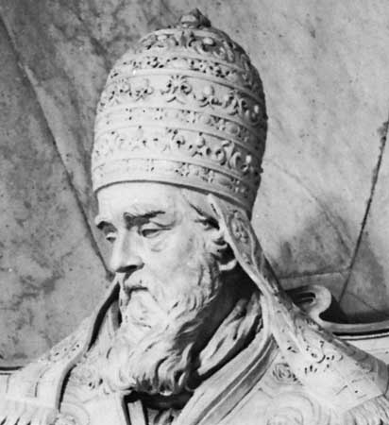
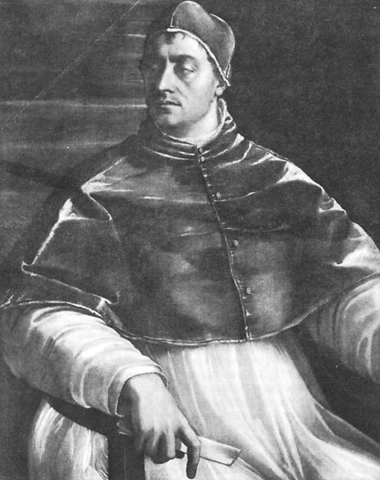
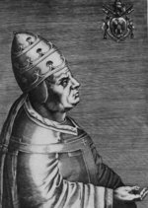
Gregory XI died
Two months later Cardinals elected another pope. Clement VII
Feeling pressured to choose an Italian, the Cardinals chose Urban VI

Slide 21
Now there were two popes. Each declared the other to be a false pope, excommunicating his rival.

Slide 22
You are a false Pope!!!
I know you are but what am I?

Slide 23
Oh yeah?? Well I excommunicate you!!
You can't!! Because I just excommunicated you!!

Slide 24
The French pope lived in Avignon, while the Italian pope lived in Rome.
Church
French Pope
Clement VII
Italian Pope
Urban VI
This began the split in the Church known as the Great Schism, or division.

Slide 25
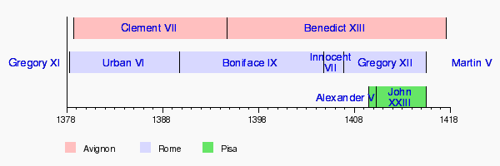
In 1414, the Council of Constance attempted to end the Great Schism by choosing a single pope.
By now, there were a total of three popes!!
The Avignon pope
The Italian pope
and a third pope elected by an earlier council at Pisa!!
http://en.wikipedia.org/wiki/Western_Schism

Slide 26
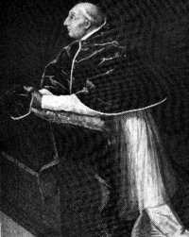
With the help of the Holy Roman Emperor, the council forced all three popes to resign.
In 1417, the Council chose a new pope, Martin V, ending the Great Schism but leaving the great papacy weakened.

Slide 27
100 years War- started as a fight over a small duchy in France. King of England v. King of France smack down. The 100 Years War was an important turning point in warfare, peasant foot soldiers NOT knights, won the chief battles of this war. English soldiers were armed with pikes and also longbows. (had greater striking power and longer range than crossbow.

Slide 28
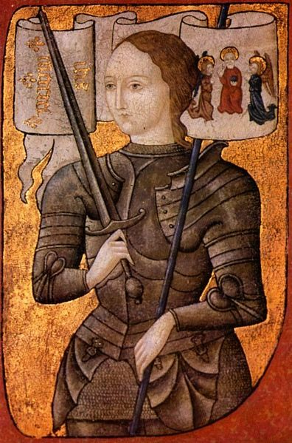
In 1420, the French and English signed a treaty stating that Henry V would inherit the French crown upon the death of the French king Charles VI.
Then, in 1429, a teenage French peasant girl named Joan of Arc felt moved by God to rescue France from its English conquerors.

Slide 29
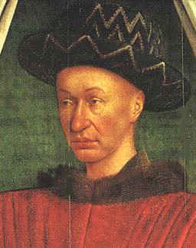
When Joan was just 13 she began to have visions and hear what she believed were voices of the saints. They urged her to drive the English from France and give the French crown to France's true king, Charles VII, son of Charles VI.

Slide 30
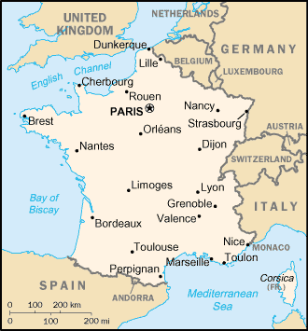
On May 7, 1429, Joan led the French army into battle at a fort city near Orleans. The fort blocked the road to Orleans. It was a hard-fought battle for both sides. The French finally retreated in despair. Suddenly, Joan and a few soldiers charged back toward the fort. The entire French army stormed after her. The siege Of Orleans was broken. Joan of Arc guided the French onto the path of victory.

Slide 31
After that victory, Joan persuaded Charles to go with her to Reims. There he was crowned king on July 17, 1429. In 1430, the Burgundians, England's allies, captured Joan in battle. They turned her over to the English. The English, in turn , handed her over to Church authorities to stand trial.
Although the French king Charles VII owed his crown to Joan, he did nothing to rescue her.

Slide 32
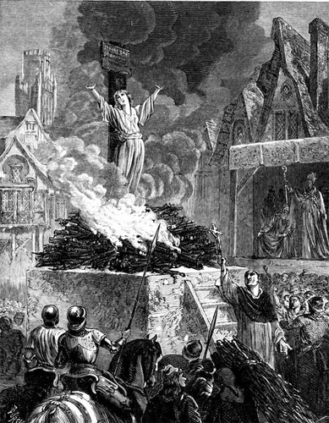
Condemned as a witch and a heretic because of her claim to hear voices, Joan was burned at the stake on May 30, 1431.

Slide 33
The long exhausting war finally ended in 1453. Each side experienced major changes.
A feeling of nationalism emerged in England and France. Now people thought of the king as a national leader, fighting for the glory of the country, not simply a feudal lord.
The power and prestige of the French monarch increased

Slide 34
Spain, too, experienced the growth of a strong national monarchy at the end of the fifteenth century.
Two of the strongest kingdoms were Aragon and Castile. When Isabella of Castile married Ferdinand of Aragon in 1469, it was a major step toward unifying Spain. The two rulers worked to strengthen royal control of the government.
Ferdinand and Isabella also pursued a policy of strict conformity to Catholicism.

Slide 35
In 1492, they took the drastic step of expelling all professed Jews from Spain. Muslims, too, after their final loss in 1492 were "encouraged" to convert to Catholicism.
In 1502, Isabella issued a decree expelling all professed Muslims from her kingdom. To a very large degree, Ferdinand and Isabella, the "most Catholic" monarchs, had achieved their goal of religious uniformity. To be Spanish was to be Catholic.

Slide 36
Section 4 Review:
1. What was a major cause of anti-Semitism in Medieval Europe?
2. What were Ferdinand and Isabella referred to as?

