Slide 1
AGENDA WEDNESDAY
GET A WHITEBOARD FOR YOU AND YOUR PARTNER
1-READ P. 68-72 1ST 10 MINUTES OF CLASS
NOTES/PPT POINT/WHITEBOARD CHALLENGES

Slide 2
Ch. 4 & 6
European Middle Ages
&
The Crusades

Slide 3
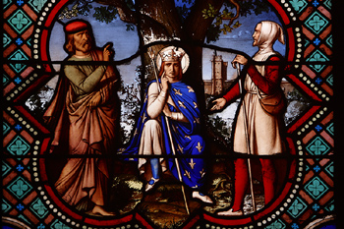
Medieval Europe
Notes:
Knights in armor, the Crusades, castles and great cathedrals, the Black Death, the Magna Carta—all of these are part of the historical period called the Middle Ages, also known as the medieval era. When was this and how did this period influence the development of western civilization?

Slide 4
Defining the Medieval Period
Classical Civilization
(Beginning of European Civilization →
Roman Empire)
Medieval Europe
(Fall of Rome → Before the Renaissance)
Modern Times
(Renaissance → Today)
The time period has also been called the “Middle Ages” and the “Dark Ages”
Notes:
There is some debate concerning the beginning and the end of the medieval period. Historians usually place the medieval era from approximately 500 CE to 1500 CE, or the period between the fall of the Roman Empire and the beginning of the Renaissance.
Europe during this time period has also been called:
“The Middle Ages”—This refers to the fact that this time is situated between Classical Europe and more modern times. “Medieval” comes from the Latin medium aevum, which translates loosely as “Middle Ages.”
“The Dark Ages”—This was a term used in the 15th and 16th centuries by those who believed the era lacked social or artistic worth—a somewhat unfair criticism. Historians generally avoid using this overly judgmental term.

Slide 5
Medieval Europe: Stages
Early Medieval Europe
(c. 500–1000)
High Medieval Europe
(c. 1000–1300)
Late Medieval Europe
(c. 1300–1500)
Notes:
The Middle Ages can be broken down into three time periods, each made distinctive by major civilization-changing events:
Early Middle Ages—After the fall of the Roman Empire, small independent kingdoms arose throughout western Europe. This era also witnessed the birth of feudalism, a system of sovereignty and protection which will be discussed later in this presentation.
High Middle Ages—During this era, Christianity became a dominant force, uniting western Europe under the authority of the Catholic Church. The Crusades occurred during this time period, allowing territorial leaders to bring diverse groups together and command authority by ordering people to defend their beliefs against the mounting threat of Islam.
Late Middle Ages—This era was characterized by the decline of feudalism and the rise of nation-states ruled by royal families. Events during this time period also included the Hundred Years’ War and the spread of the bubonic plague (the “Black Death”), which killed between one-third and one-half of the population of Europe.

Slide 6
From about 800 to 1000, invasions destroyed the Carolingian Empire. Muslim invaders from the South seized Sicily and raided Italy. In 846 they sacked Rome. Magyar invaders struck from the East. From the North came the fearsome Vikings.
As Vikings gradually accepted Christianity, they stopped raiding monasteries. Also, a warming trend in Europe's climate made farming easier in Scandinavia. As a result, fewer Scandinavians adopted the seafaring life of Viking warriors.

Slide 7
As Viking invasions declined, Europe became the target of new assaults. The Magyars, a group of nomadic people, attacked from the East, from what is now Hungary.
The Muslims struck from the South. They began their encroachments from their strongholds in North Africa, invading through what are now Italy and Spain.

Slide 8
Invasions by Vikings, Magyars, and Muslims caused widespread disorder and suffering. Most western Europeans lived in constant danger.
Kings could not effectively defend their lands from invasion. As a result, people no longer looked to a central ruler for security.
Instead, many turned to local rulers who had their own armies. Any leader who could fight the invaders, gained followers and political strength.

Slide 9
WHITE BOARD CHALLENGE
To whom did peasants look for protection and security during Medieval Times?
Medieval Europe was between _________ and __________ CE.

Slide 10
WHITE BOARD CHALLENGE
To whom did peasants look for protection and security during Medieval Times? LOCAL RULERS
Medieval Europe was between ___500______ and ___1500_______ CE.

Slide 11
The system of governing land and landholding, called feudalism, had emerged in Europe. A similar feudal system existed in China under the Zhou dynasty, which ruled from around the 11th century B.C. until 256 B.C.
The feudal system was based on rights and obligations. In exchange for military protection and other services, a lord, or landowner, granted land called a fief (rhymes with theif). The person receiving a fief was called a vassal.

Slide 12
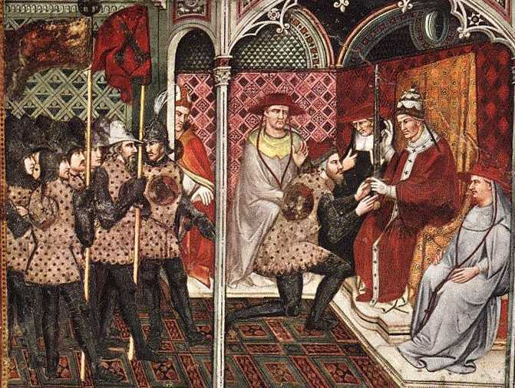
Feudalism
A political, economic, and social system in which land was allocated in exchange for services; roles and obligations were clearly defined for all participants
Grew out of Roman practices of clientage/patronage
Originally developed as a means of protection and defense
A French vassal receiving a feudal grant from the king
Notes:
Feudalism developed out of peoples’ need for protection against invaders and landowners’ need to defend their property. The feudal system grew out of the practices of “clientage” or “patronage” which had existed under the Roman Empire; these practices involved smaller landowners placing themselves under the protection of larger landowners, usually in exchange for payment or goods. In medieval feudalism, individual monarchs throughout Europe were unable to afford protection of their empires, so they gave trusted soldiers parcels of land in exchange for their promise to defend it and make it useful.
Feudalism appeared in Europe during the 700s in the areas we know now as France and Germany, as weak governments sought solutions to the question of how to provide security with limited resources. By the 1000s, most of western Europe practiced some form of feudalism.

Slide 13
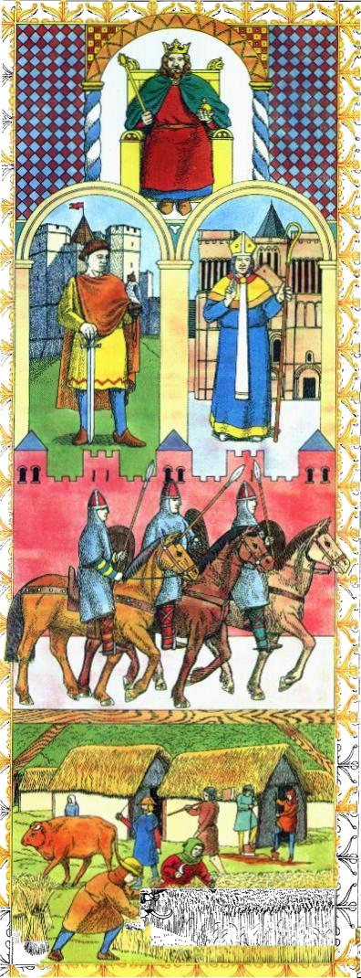
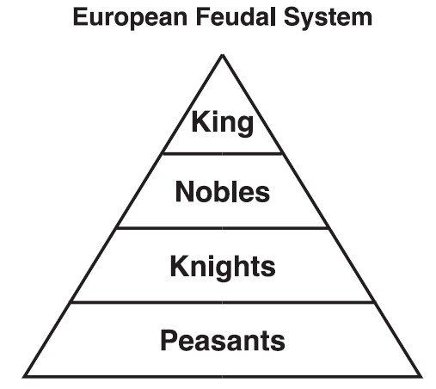

Slide 14
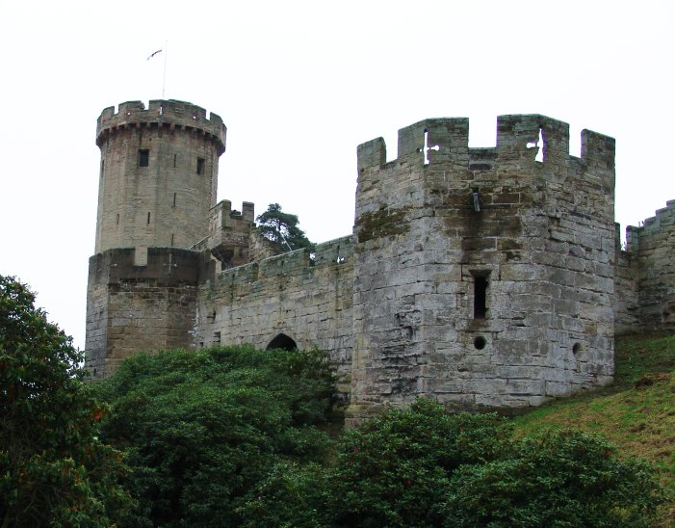
Castles
Centers of noble life
Purposes:
  Intimidation
  Military defense
  Residence
Warwick Castle, England
Notes:
Castles were centers of life for nobles and knights, serving as homes and fortresses. Building a castle was often a lifelong pursuit for nobles; some castles would even take several generations to complete. Castles were usually constructed by serfs and masons (craftsmen who worked with stone). Once erected, these buildings would serve a number of purposes:
Intimidation—Castles were often built in the spirit of competition with other nobles, friendly or otherwise. A large castle could serve as a sign of a noble’s strength, esteem, or power. Castles were often placed on the highest point in a region so they could be seen from great distances.
Military defense—Castles were most certainly built with military use in mind. They had clever defensive designs, incorporating elements such as moats, large watchtowers, and high walls. Castles were sometimes built on the outer regions of a noble’s land grant as a means of encroaching on another noble’s territory.
Residence—Nobles and their families lived in castles. The castles of the higher nobles were often lavishly decorated, with rich tapestries on the walls, grand halls, and music rooms.
Castles were dark, lit only by torches and fireplaces. The rooms were large and drafty because windows did not have glass in them.

Slide 15
In the feudal system, status determined a person's prestige and power. Medieval writers classified people into three groups:
Those who fought (nobles and knights)
Those who prayed (men and women of the church)
and Those who worked (the peasants)
Social class was usually inherited.
In Europe, in the Middle Ages, the vast majority of people were peasants. Most peasants were serfs. Serfs were people who could not lawfully leave the place where they were born. Though bound to the land, serfs were not slaves. Their lords could not sell nor buy them.
But what their labor produced belonged to the lord.

Slide 16
The manor was the lord's estate. During the Middle Ages, the manor system was the basic economic arrangement that supported the social arrangement of feudalism. The manor system rested on a set of rights and obligations between a lord and his serfs. The lord provided the serfs with housing, farmland, and protection from bandits. In return, serfs tended to the lord's lands, cared for his animals, and performed other tasks to maintain the estate.
All peasants, whether free or serf, owed the lord certain duties. These included at least a few days of labor each week and a certain portion of their grain.

Slide 17
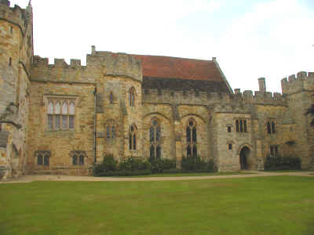
Peasants rarely traveled more than 25 miles from their own manor. A manor usually covered only a few square miles of land. It typically consisted of the lords' manor house, a church and workshops. Generally, 15 to 30 families lived in the village on the manor.

Slide 18
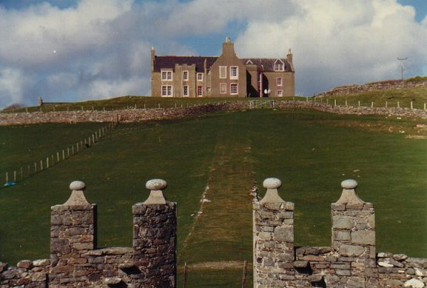

Slide 19
WHITE BOARD CHALLENGE
GRANTED LAND FROM A LORD IS CALLED A ________________________.
PERSON RECEIVING IT IS CALLED A ________________________.
TWO PURPOSES OF A CASTLE ARE _________________ AND ____________________.
Manor consists of ________________, ______________________ and _____________________________.

Slide 20
WHITE BOARD CHALLENGE
GRANTED LAND FROM A LORD IS CALLED A _____fief______.
PERSON RECEIVING IT IS CALLED A ______vassal________.
TWO PURPOSES OF A CASTLE ARE __defense, intimidation________ AND ______residence______.
Manor consists of __house____, ____church_______ and ____workshops______.

Slide 21
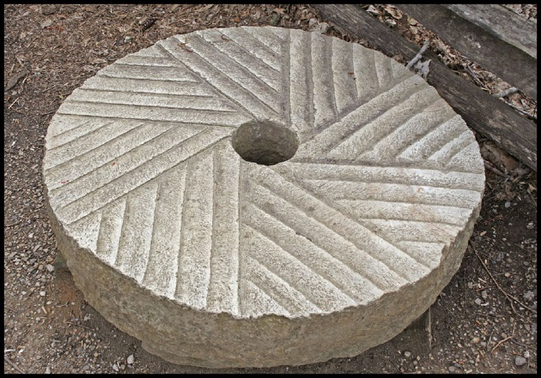
Sometimes, a stream would flow through the manor. Streams and ponds provided fish, which served as an important source of food. The mill for grinding grain was often located on the stream.
The manor was largely a self sufficient community. the serfs and peasants raised or produced nearly everything that they and their lord needed for daily life-crops, milk and cheese, fuel, cloth, leather goods, and lumber. The only outside purchases were salt, iron, and a few unusual objects such as millstones.
Millstones are huge stones used to grind flour.
Crops grown on the manor usually included grains, such as wheat, rye, barely, and oats, and vegetables, such as peas, beans, onions, and beets.

Slide 22
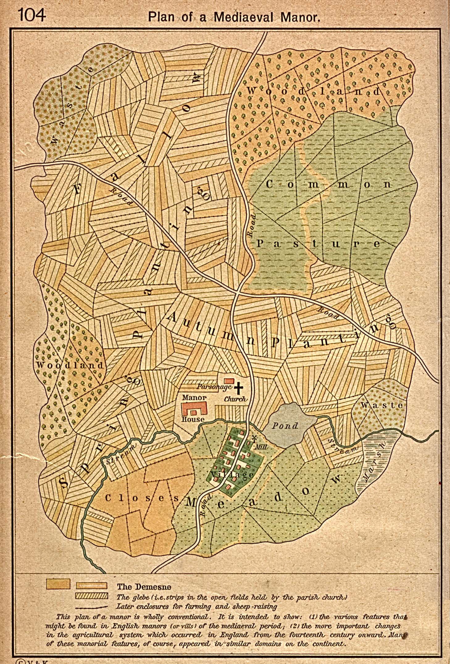

Slide 23
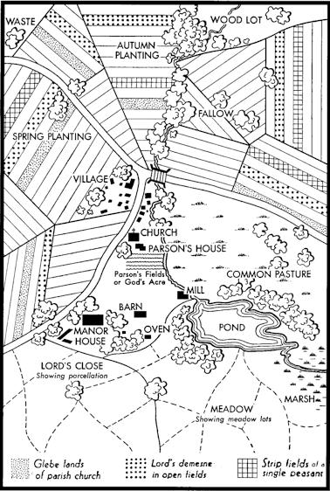

Slide 24
For the privilege of living on the lord's land, peasants paid a high price.
They paid a high tax on all grain ground in the lord's mill. Any attempt to avoid taxed by baking bread elsewhere was treated as a crime.
They were taxed on almost everything produced on the lord's land.

Slide 25
Peasants also paid a tax on marriage. Weddings could take place only with the lord's consent.
After all these payments to the lord, peasants owed the village priest, a tithe, or church tax.
A tithe represented one-tenth (10%) of their income.

Slide 26
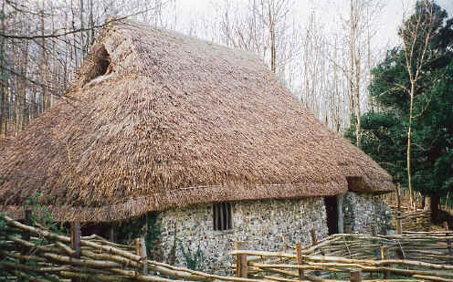
Serfs lived in crowded cottages, close to their neighbors. The cottages had only one or two rooms. If there were two rooms, the main room was used for cooking, eating, and other household activities. The second was the family bedroom.
Peasants warmed their dirt-floor houses by bringing pigs inside. At night, the family huddled on a pile of straw that often crawled with insects.

Slide 27
The simple diet of a peasant consisted mainly of vegetables, coarse brown bread, grain, cheese and soup.
Illness and malnutrition were constant afflictions for medieval peasants. Average life expectancy was about 35 years.
Yet, despite the hardships they endured, serfs accepted their lot in life as part of the Church's teaching. They, like most Christians during medieval times, believed that God determined a person's place in society.

Slide 28
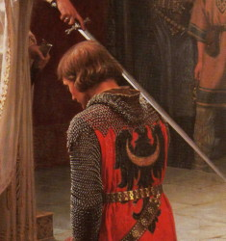
Knights were expected to display courage in battle and loyalty to their lord. By the 1100s, the code of chivalry, a complex set of ideals, demanded that knights fight bravely in defense of three masters. He devoted himself to:
His earthly feudal lord
His heavenly Lord
His chosen lady
The code of chivalry was developed to stop the constant, brutal fighting among nobles.
The chivalrous knight also protected the weak and the poor. The ideal knight was loyal, brave, and courteous.

Slide 29
Sons of nobles began training for knighthood at an earl age and learned the code of chivalry.
At age 7, a boy would be sent off to the castle of another lord. As a page, he waited on his hosts and began to practice fighting skills.
At around the age of 14, the page reached the rank of squire. A squire acted as a servant to a knight.
At the age of 21, a squire became a full fledged knight.

Slide 30
WHITE BOARD CHALLENGE
PEASANTS KEPT THEIR HOUSES WARM AT NIGHT BY ____________________________________________________.
AVERAGE LIFE EXPECTANCY WAS _________________- YEARS OLD
KNIGHTS CODE OF ____________________: DEVOTION TO ______________, _____________________ AND ______________________.
BOYS’ ROAD TO KNIGHTHOOD:
AGE 7 -______________________
Age 14-________________________
Age ____-knight

Slide 31
WHITE BOARD CHALLENGE
PEASANTS KEPT THEIR HOUSES WARM AT NIGHT BY _____bringing in the animals at night__.
AVERAGE LIFE EXPECTANCY WAS ___35___- YEARS OLD
KNIGHTS CODE OF __CHIVALRY_____: DEVOTION TO _THE LORD___, __EARTHLY LORD______ AND ____CHOSEN LADY_____.
BOYS’ ROAD TO KNIGHTHOOD:
AGE 7 -___PAGE_______
Age 14-_____SQUIRE_________
Age _21_-knight

Slide 32
After being dubbed a knight, most young men travel for a year or two. The young knights gained experience fighting in local wars. Some took part in local tournaments.
Tournaments combined recreation with combat training.
Two armies of knights charged each other. Trumpets blared, and lords and ladies cheered. Like real battles, tournaments were fierce and bloody competition. Winners could usually demand large ransoms from defeated knights.

Slide 33
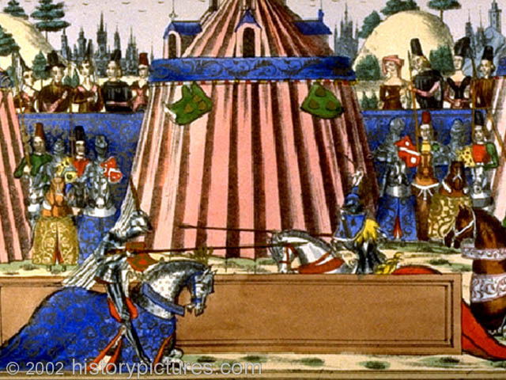
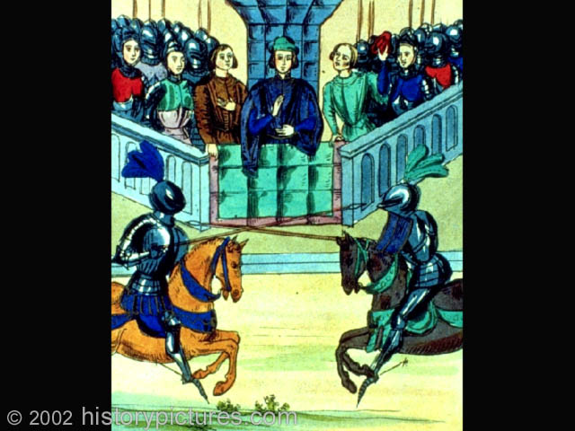
The Medieval Tournament
Means of practicing military skills
Notes:
Knights practiced their military skills in exercises known as “tournaments”—mock battles that involved both real weapons and actual combat (though some tournaments outlawed points on swords). Tournaments ranged from small affairs with a handful of knights to grand, staged affairs played out in front of large audiences. Rules varied throughout the ages, but as tournaments became more violent, the various monarchs of Europe sought to limit—or, in some cases, to ban—the practice. Another popular sport in late medieval Europe was jousting, which involved two knights charging each other on horseback and attempting to dismount one another.

Slide 34
Under the code of chivalry, a knight's duty to his lady became as important as his duty to his lord. In many medieval poems, the hero's difficulties resulted from a conflict between those two obligations.
https://www.youtube.com/watch?v=jamZyBva_LE

Slide 35
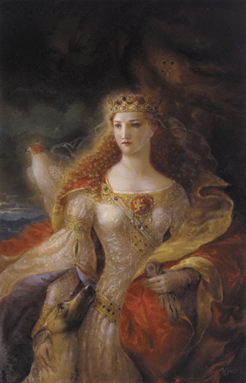
The most celebrated woman of the age was Eleanor of Aquitaine. Troubadours flocked to her court in the French duchy of Aquitaine. Later, as queen of England, Eleanor was the mother of two kings, Richard the Lion-Hearted and John.

Slide 36
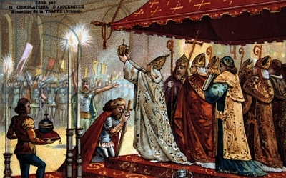
In crowning Charlemagne as the Roman Emperor in 800, the Church sought to influence both spiritual and political matters.
Throughout the Middle Ages, the Church and various European rulers competed for power.

Slide 37
Like the system of feudalism, the Church had its own organization. Power was based on status. Church structure consisted of different ranks of clergy, or religious officials.
The pope in Rome headed the Church.
All clergy, including bishops and priests, fell under his authority.
Bishops supervised priests, the lowest ranking members of the clergy. Bishops also settled disputes over Church teachings and practices. For most people, local priests served as the main contact with the Church.

Slide 38
Pope
Bishop
Bishop
Bishop
Priest
Priest
Priest
Priest
Priest
Priest
Priest
Priest
Priest
Priest
Priest
Priest
Congregation
Congregation
Congregation
Congregation
Congregation
Congregation
Congregation
Congregation
Congregation
Congregation
Congregation
Congregation

Slide 39
Catholic Church Hierarchy
The
Pope
Cardinals
Archbishops
Bishops
Priests

Slide 40
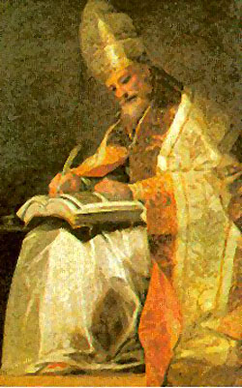
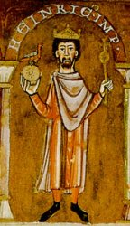
The Catholic Church
Expands Its Power
The Church becomes more of a political entity
Struggles with monarchs
  POPE Gregory VII and Henry IV
  (In the 11th century Pope Gregory VII excommunicated the Holy Roman Emperor, Henry IV. Their disagreement was about who had the right to appoint church officials. When he excommunicated Henry IV, Pope Gregory also told Henry’s vassals (noblemen who rented the Emperor’s lands) that they did not need to give their support to the Emperor anymore. Once the pope had told them that they did not owe anything to Henry, the German vassals staged a revolution. Henry was forced to give in, and he had to go to Pope Gregory to apologize. The pope left Henry standing for three days in the snow before he would see him. When things returned to normal, however, Henry went to Rome and threw the pope out. Gregory was forced into exile, and he died in Salerno in 1085.
Expanded land ownership
Pope Gregory VII
Henry IV of Germany
Notes:
In the 11th century Pope Gregory VII excommunicated the Holy Roman Emperor, Henry IV. Their disagreement was about who had the right to appoint church officials. When he excommunicated Henry IV, Pope Gregory also told Henry’s vassals (noblemen who rented the Emperor’s lands) that they did not need to give their support to the Emperor anymore. Once the pope had told them that they did not owe anything to Henry, the German vassals staged a revolution. Henry was forced to give in and he had to go to Pope Gregory to apologise. The pope left Henry standing for three days in the snow before he would see him. When things returned to normal, however, Henry went to Rome and threw the pope out. Gregory was forced into exile, and he died in Salerno in 1085.

Slide 41
Feudalism and the manor system created divisions among people, but the shared beliefs in the teachings of the Church bonded people together. The church was a stable force during an era of constant warfare and political turmoil. It provided Christians with a sense of security and of belonging to a religious community.
In the Middle Ages, religion occupied center stage.

Slide 42
Medieval Christians' everyday lives were harsh. Still, they could all follow the same path to salvation-everlasting life in heaven. Priests and other clergy administered the sacraments, or important religious ceremonies. These rites paved the way for achieving salvation.
Baptism
Confirmation
Eucharist
Penance
Last Rites
Holy Orders
Matrimony

Slide 43
The Church's authority was both religious and political. It provided a unifying set of spiritual beliefs and rituals. The Church also created a system of justice to guide people conduct.
All medieval Christians, kings and peasants alike, were subject to canon law or Church law, in matters such as marriage and religious practices.
The Church also established courts to try people accused of violating canon law. Two of the harshest punishments that offenders faced were excommunication and interdict.

Slide 44
Popes used the threat of excommunication, or banishment from the Church, to wield power over political rulers.
For example, a disobedient king's quarrel with a pope might result in excommunication.
This meant the king would be denied salvation. Excommunication also freed all the king's vassals from their duties to him.
If an excommunicated king continued to disobey the pope, the pope, in turn, could use an even more frightening weapon, the interdict.

Slide 45
Under an interdict, many sacraments and religious services could not be performed in the king's lands. As Christians, the kings subjects believed that without such sacraments they might be doomed to hell.
In the 11th century, excommunication and the possible threat of an interdict would force a German emperor to submit to the pope's commands.

Slide 46
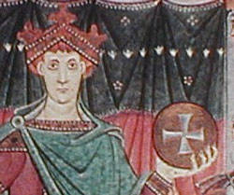
The most effective ruler of medieval Germany was Otto I, known as Otto the Great. Otto, crowned king in 936, followed the policies of his hero, Charlemagne. Otto formed a close alliance with the Church, by gaining the support of the bishops and abbots, the heads of monasteries.
The German-Italian empire Otto created later became known as the Holy Roman Empire. It remained the strongest state in Europe until about 1100.

Slide 47
Frederick I, nicknamed "Barbossa" for his red beard, was the first ruler to call his lands the Holy Roman Empire. However, this regions was actually a patchwork of feudal territories.
His forceful personality and military skills enabled him to dominate the German princes.
Yet, whenever he left the country, disorder returned.

Slide 48
In 1176, the foot soldiers of the Lombard League faced Frederick's army of mounted knights at the Battle of Legnano. In an astonishing victory, the Italian foot soldiers used crossbows to defeat feudal knights for the first time in history.
In 1177, Frederick made peace with the pope and returned to Germany.
His defeat, though, had undermined his authority with the German princes. After he drowned in 1190, his empire fell to pieces.

Slide 49
German kings after Frederick, including his grandson Frederick II, continued their attempts to revive Charlemagne's empire and his alliance with the Church.
This policy led to wars with Italian cities and to further clashes with the pope.
These clashes were one reason why the feudal states of Germany did not unify during the Middle Ages.
Another reason was that the system of German princes electing the king weakened royal authority.
German rulers controlled fewer royal lands to use as a base of power than French and English kings of the same period.

Slide 50
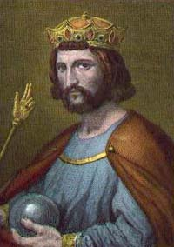
France
Hugh Capet (938–996)
  Founder of Capetian dynasty
Philip II (1180–1222)
  (known as Philip Augustus)
  Participated in 2nd crusade
Most powerful kingdom in Europe by the 14th century
Hugh Capet
Notes:
Beginning in the 8th century, foundations were laid for many modern European nations. Although the borders would stay fluid for many coming centuries, the political basis for countries like France, England, and Spain began to appear.
In 987, the Capetian dynasty assumed French rule under Hugh Capet (“capet” is a nickname meaning “wearing a cape”). At the time, France was a collection of semi-independent states that included Normandy, Flanders, Anjou, and Aquitaine. Capet thus had limited royal authority and the nobles in the territories gave him only token allegiance.
Later, Philip II managed to bring several feudal territories claimed by England under French control. His military successes also enabled him to gain more authority over the nobility. By the reign of Philip IV (1285–1314), France had become the most powerful state in Europe.

Slide 51
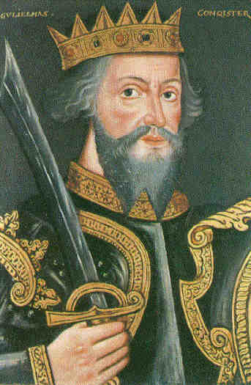
England
1066: Norman Invasion
  Battle of Hastings
William the Conqueror (1027–1087)
  Brought feudalism to England
Henry II (1154–1189)
  Instituted a single common law code, unified court system
William the Conqueror
Notes:
In 1066, the Normans—a French-speaking group of Viking descendants who had settled in Northern France—invaded England and toppled the Saxon king. Under William the Conqueror, the Normans established an Anglo-Norman government that slowly integrated traditional customs of the region with Norman traditions. William the Conqueror imported French-style feudalism into England.
After William’s death in 1087, England went through a time of brief destabilization as his heirs fought over his titles and property. The country regained its strength under Henry II (1154–1189). Henry instituted a single common law code which applied equally to citizens; he also created a unified court system which included jury trials.

Slide 52
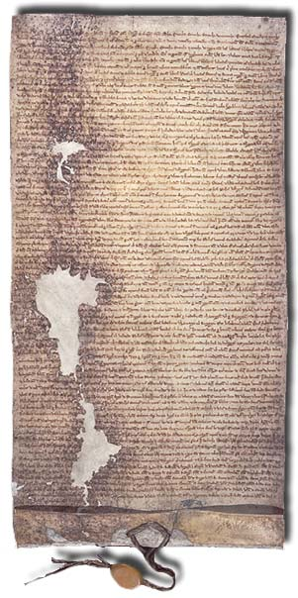
Magna Carta (1215)
Conflict between King John and the English nobility
Nobles rebelled against excessive taxation, forced King John to sign the Magna Carta in 1215
  Limited power of the monarch
  Formal recognition that the king was not above the law
A photograph of the Magna Carta
Notes:
England experienced many instances of conflict between the king and the nobility. The situation became critical under King John. In an effort to raise money for war against France, John levied excessive taxes, thereby weakening his support throughout the country. After John was defeated in France, the nobles rebelled against him and forced him to sign the Magna Carta (Latin for “great charter”), a document that guaranteed rights to nobles and dramatically limited the power of the king. In practice, it meant that a “great council” made up of the king’s leading vassals had to approve any taxes levied beyond the king’s personal revenue. In theory, the Magna Carta established the principle that the king was not above the law. Ordinary English people did not benefit from this immediately, but over time the principles of the document were extended to protect the rights of all citizens.

Slide 53
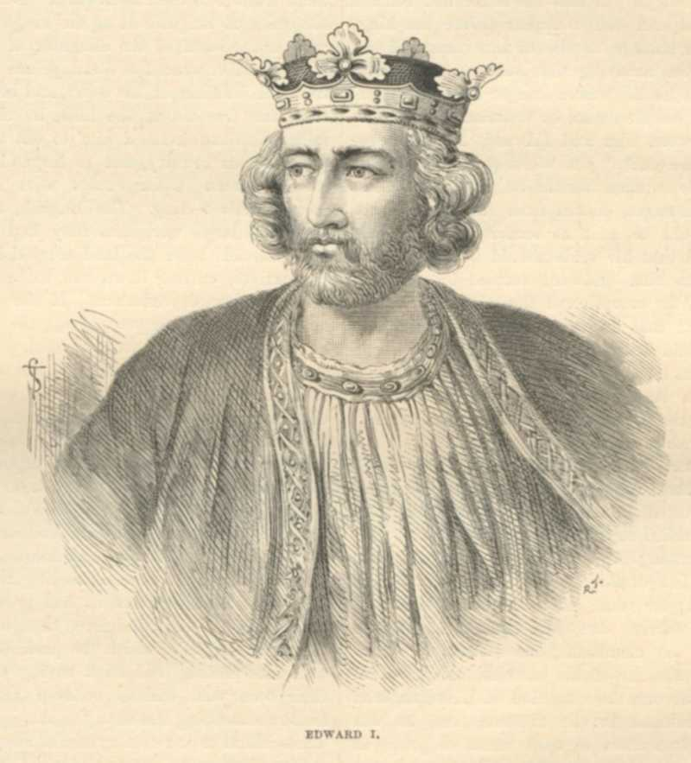
Development of Parliament
Henry III (1216–1272)
Edward I (1239–1307)
Original parliament
  House of Lords: nobles and church lords
  House of Commons: knights and residents
Approved taxes, discussed policies, worked with the monarch to make laws
Edward I
Notes:
As the 13th century progressed, English kings continually needed money—especially for war. The great council, later called Parliament (from the French parler, meaning “to speak”), wanted to control royal spending—and the power of the monarch. When Henry III resisted Parliament’s attempt to extend its influence, a rebellion ensued. Henry was temporarily removed and replaced by a parliament led by one of the nobles. Henry’s son Edward I retook the throne in 1265. Edward wanted to be granted the power to collect more money from the people and called for two knights from every county and two residents from every town to be assembled with the king’s Great Council. This was considered to be England’s first representative parliament. Eventually, Parliament was organized into two tiers: The House of Lords was made up of noblemen and church leaders, while the House of Commons was comprised of knights and town residents. Parliament approved taxes, discussed policies, and worked with the monarch to make laws.

Slide 54
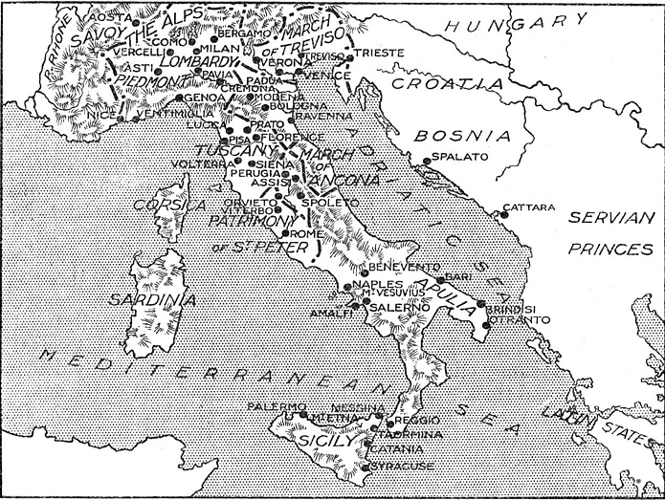
Italian City-States
Many city-states on the Italian peninsula
Changed hands often; controlled at times by Germanic tribes, Byzantines, and the French
Rome and the Papal States remained important
Medieval Italy
Notes:
After the fall of the Roman Empire, the various states located on the Italian peninsula remained independent of one another. Often referred to as “city-states” because many comprised an area only as large as a single city, these territories were sometimes controlled by Germanic tribes and at other times under the rule of the Byzantines or the French. One of the few exceptions was the Papal States, which included the city of Rome. This area remained important due to its location as the headquarters of the Catholic Church.

Slide 55
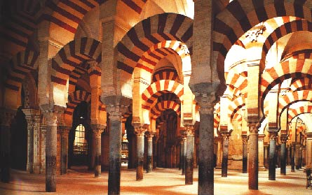
Islam in Europe
Islamic forces took control of Spain in the early 8th century
Muslim innovations
  Agriculture
  Architecture
  Math and science
Great Mosque of Córdoba
Notes:
Islam had arisen on the Arabian peninsula in the early 7th century and had continued to spread after the death of Muhammad, its founder, in 632. Under the leadership of the Umayyad dynasty, Islamic territory expanded into Europe: by 710 they controlled North Africa, and in 711 they moved across the Strait of Gibraltar and invaded the Iberian Peninsula (modern-day Spain and Portugal). By 725, Muslims controlled most of Spain, with the city of Córdoba acting as the Muslim “capitol.”
Muslim innovations had a significant impact on Spain. In agriculture, the Muslims introduced new crops such as oranges, dates, and rice, as well as new methods of irrigation that significantly improved productivity. Muslim architects introduced new designs that would influence building in Spain for years. Numerous mosques and palaces were built, including the Alhambra in Granada and the Great Mosque at Córdoba, which was constructed with a complex interior consisting of a multitude of low, rounded arches made of alternating black and white stones. In addition, Arabic knowledge in science, mathematics, and medicine was far superior to anything in Europe at the time. For example, Arabic numerals (i.e., 1, 2 ,3, instead of the Roman I, II, III) became the standard in algebra, mathematics, astronomy, and physics; the Muslims also introduced the concept of “zero” to Europe.

Slide 56
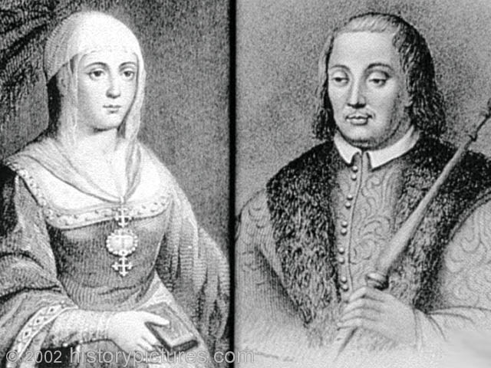
The Reconquista of Spain
Muslims ruled the Iberian Peninsula for nearly 800 years
Reconquista: Struggle between Christians and Muslims to control Spain
718–1492
King Ferdinand of Aragon and Isabella of Castile
Isabella and Ferdinand
Notes:
The Iberian peninsula was dominated by the Muslims for nearly 800 years, a rule which began in the 8th century. The Reconquista—the struggle between Christians and Muslims to control the territory—happened across several centuries, from 718 to 1492. Over this time, Christian forces slowly pushed the Muslims to the south. The Reconquista left Spain divided, as each region would develop a separate government after gaining their autonomy from the Muslims. The majority of Spain was finally unified under King Ferdinand of Aragon and Queen Isabella of Castile with the final expulsion of the Muslims in 1492.

Slide 57
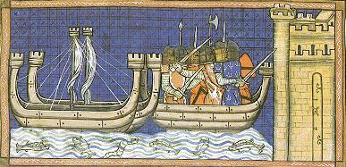
The Crusades
Louis IX of France leads crusaders against Damietta, in Egypt
Goals of the Crusades: 1095–1291
  Convert nonbelievers
  Eliminate heretics
  Regain control of the Holy Land from the Muslims
Notes:
The term “crusade” refers in general to a holy war; however, it is mostly associated with the medieval-era Crusades that went on from 1095–1291. The death of Charlemagne and the subsequent collapse of his empire, the Muslim invasion of Spain, and the fact that Muslims had gained control of the Holy Land made Christian Europe feel as if it were under attack. Some crusades were launched in an attempt to convert large numbers of nonbelievers; others were launched to fight against behavior and beliefs that the Christian Church found offensive. The Crusades also targeted heretics—other Christians who did not conform—and non-Christians, especially those of the Muslim faith. Finally, crusaders also fought to regain control of the Holy Land from Muslims.

Slide 58
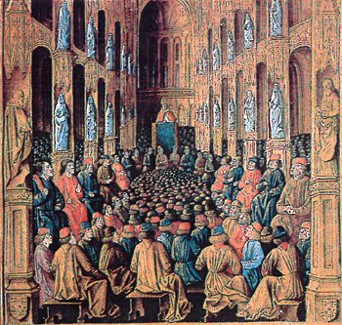
Pope Urban II
1095: Pope Urban II’s speech
  Promised spiritual rewards
  Thousands responded to the call for religious warriors
Pope Urban II calling for the Crusades
Notes:
Pope Urban II (1042–1099) sparked the First Crusade by making a dramatic plea to a crowd in France in 1095 for warriors to organize and travel to the Middle East to liberate the Holy Lands from the Muslims. The Pope promised spiritual rewards for the fighters, including forgiveness of their sins in exchange for their service. The speech was so effective that thousands of soldiers marched East the next year to retake the Holy Lands.

Slide 59
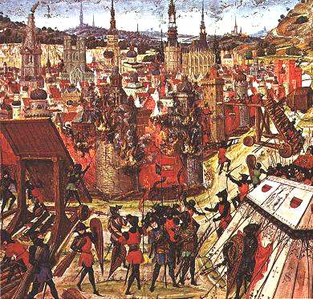
The First Crusade (1096–1099)
1096: Mostly French knights
Captured Jerusalem in 1099
Crusader states
Jerusalem taken by Muslim forces under Saladin in 1187
A depiction of the capture of Jerusalem by crusaders
Notes:
French crusader-knights, referred to as “pilgrims,” left Europe to liberate the Holy Lands from the Muslims in 1096. The army traveled first to Constantinople and then to the Middle East, drawing out Muslim fighters throughout their journey. They were able to capture Jerusalem by 1099 after a siege that lasted several weeks. After breaking through the city walls, they killed almost every non-Christian they came across, and also killed several Christians they mistook for Muslims or Jews.
As a result of the First Crusade, several small crusader states were created, most notably the Kingdom of Jerusalem. These states were isolated amid Muslim territory, however, and in the 1100s the Muslims began to conquer them. In 1187, forces led by the great Muslim commander Saladin recaptured Jerusalem.

Slide 60
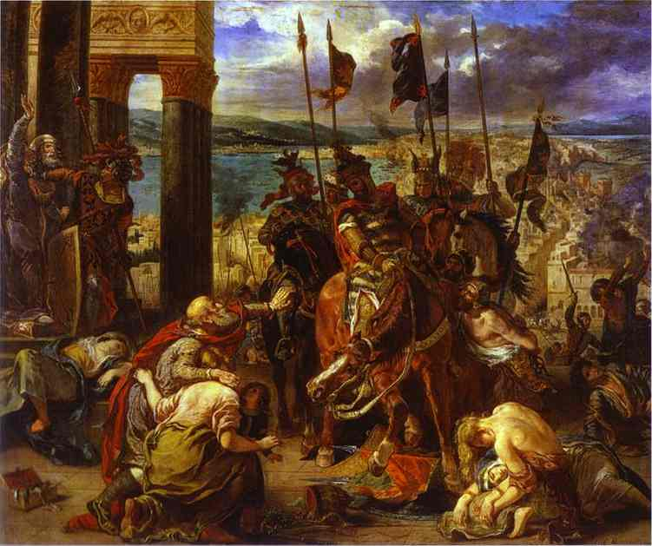
Other Crusades
Major and minor crusades took place between the 12th and 14th centuries
Christians unsuccessful at recapturing the Holy Land
Popes invoked crusades more often and for non-spiritual purposes
Legacy of the Crusades:
  Increased trade
  Religious tensions arose
The Crusade on Constantinople
Notes:
Three major and several minor crusades followed the initial one. They all failed in that the Holy Land was never returned to Christian hands. Pope Urban had shown moral leadership in 1095, but subsequent popes invoked crusades too frequently and over less significant matters. The later crusades became more worldly and less spiritual in purpose. For example, on his return from the Third Crusade, King Richard I of England (known as “Richard the Lion-Heart”) was captured by his enemy Duke Leopold of Austria and held for ransom. In the 13th century, the city-state of Venice had managed to get Frankish soldiers on the Fourth Crusade to attack and conquer Constantinople, not a Muslim stronghold.
In all, the Crusades put the Holy Land under Christian control for only a brief period of time. The Crusades did, however, lead to an increase in trade as new cross-Mediterranean trade routes arose to supply the crusaders. The rise in trade also helped spur the growth of towns and cities in Europe, and also gave rise to a new class of urban merchants.
In addition, the Crusades not only drove apart Christians, Jews, and Muslims—a rift that still has implications today—but also made the tense relationship between the Catholic Church in western Europe and the Orthodox Church in the Byzantine Empire even more fragile.

Slide 61
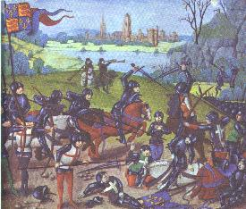
The Late Middle Ages
1300–1500
  War
  Black Death
Battle of Agincourt, 15th century
Notes:
The late Middle Ages was a time of human misery and disaster. The population of Europe suffered greatly from both the Hundred Years’ War and the Black Death, which both occurred during this time period.

Slide 62
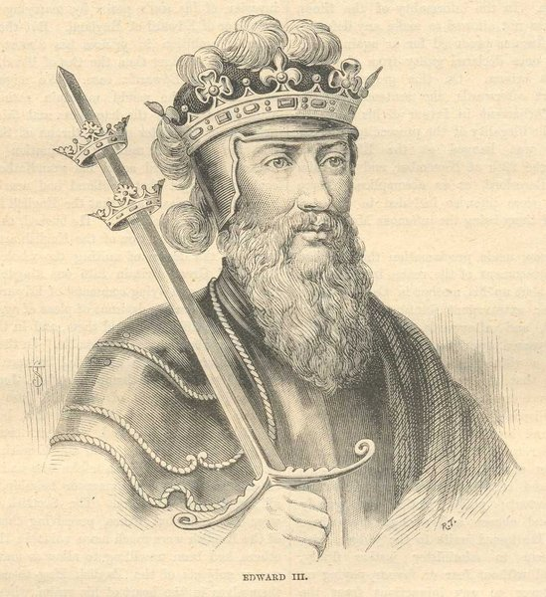
The Hundred Years’ War: Causes
The Hundred Years’ War: 1337–1453
Struggles between French and English royal families over who would rule either country
Conflicts over territory, trade
English ruler Edward III
Notes:
The Hundred Years’ War was a consequence of the growth of medieval France and England. When William the Conqueror became king of England, he tied the nobility of France to the nobility of England. As a result, tensions mounted over the years regarding who had the right to rule either country. The English and French had also become competitors in many economic pursuits, in particular the wool trade and control of Flemish towns vital to the wool trade.
Trouble began when the English claimed Aquitaine, a region in the south of France. In 1329, Edward III of England paid homage—a fee—for Aquitaine to the king of France. When Philip VI took over Aquitaine in 1337, however, Edward responded by invading France, thus beginning a series of intermittent wars that would last for 116 years.

Slide 63
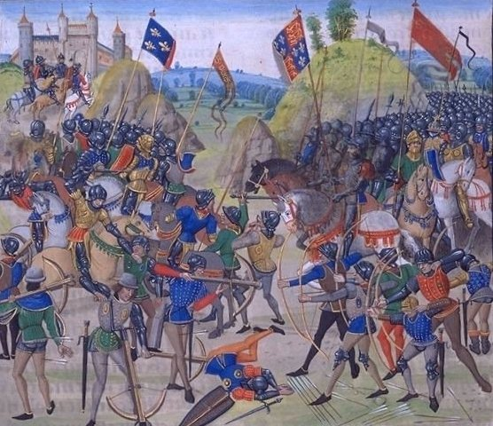
The Hundred Years’ War: Battles
England had early victories
The French eventually expelled the British from mainland Europe
English military innovation: the archer
The Battle of Crecy, the first major battle of the Hundred Years’ War
Notes:
The Hundred Years’ War started with several English victories. Many historians divide the Hundred Years’ War into four phases: two phases featured English success, each followed by the French rallying to push the English out of their lands. The war ended in 1453 when the French finally expelled the English from mainland Europe.
The English use of skilled archers during the war proved to be influential to technology of the time. It was highly effective when used against knights, whose slow, bulky armor couldn’t provide sufficient defense in the face of a multiple arrow attack.

Slide 64
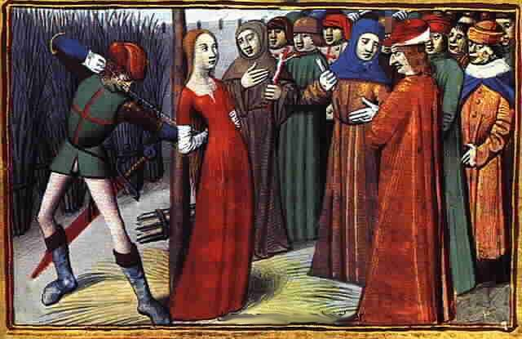
Joan of Arc
Heroine of the war
Had visions that told her to free France
Fought with the army
Captured, burned at the stake
https://www.youtube.com/watch?v=7OjBSvn0C78
https://www.youtube.com/watch?v=XGRgBJgjJ7o
Documentary on Joan of Arc
Notes:
One of the French heroines of the Hundred Years’ War was Joan of Arc. The daughter of peasants, she claimed that she heard voices that told her to expel the English from France. She managed to persuade the king that she should be allowed to fight alongside the men in the war due to her passion and faith. She became a successful soldier and her will and strength inspired the French to several victories. She was eventually captured by the English and shipped to England to face trial for heresy. Found guilty, she was burned at the stake.

Slide 65
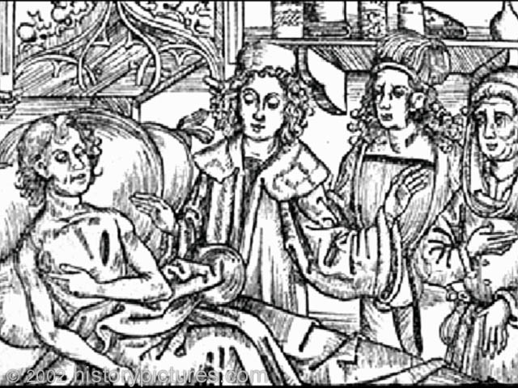
The Plague
Notes:
During the late Middle Ages and early Renaissance, the bubonic plague—commonly referred to as the “Black Death”—ravaged the population of Europe. It was transmitted to humans by fleas that had bitten infected rats. The disease caused very painful swollen lymph nodes called buboes. The name “Black Death” came from the dried blood which would often form under the skin and cause black spots.

Slide 66
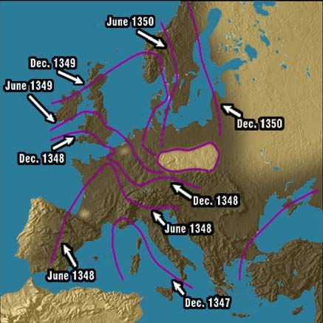
Spread of the Plague
Started in China
Reached Europe in 1347 via a merchant ship on the island of Sicily
1347–48: southern Europe
1349–50: central Europe and the British Isles
Notes:
The plague started in China and killed millions of people in mainland Asia. Due to its highly communicable nature, it spread very quickly. It first reached Europe in Sicily in 1347, when a merchant ship returning from China landed carrying rats with infected fleas. Trade and travel helped spread the plague to mainland Europe. By 1348, it had ravaged southern Europe. By 1350, it had hit central Europe and the British Isles. The plague spread for several reasons, including the outbreak of war (the Hundred Years’ War was fought while the plague affected Europe) and the fact that many infected people often brought the disease to new locations by trying to escape the horrors of the disease.

Slide 67
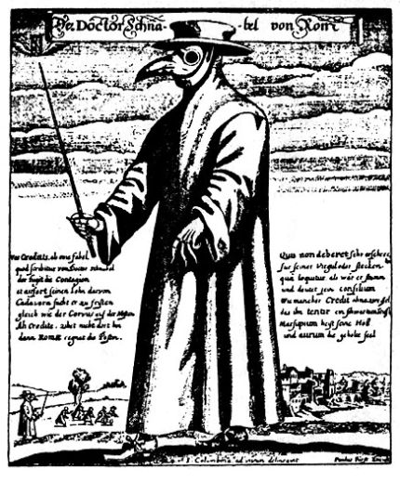
Popular Medical “Cures” for the Plague
Doctors wore strange costumes
Bathing in human urine
Wearing excrement
Placing dead animals in homes
Wearing leeches
Drinking molten gold and powdered emeralds
Burning incense to get rid of the smell of the dead
A costume worn by doctors to ward off the Plague
Notes:
At the time, the field of medicine did not understand what caused the Black Death—or how to cure it. Doctors wore strange costumes and used folk cures to deal with the disease. Among the more absurd remedies:
Bathing in human urine
Wearing excrement
Placing dead animals in homes
Wearing leeches
Drinking molten gold and powdered emeralds
Burning incense to get rid of the smell of the dead
Not surprisingly, these “cures” did little to address the real problems of the plague and many even made the disease worse.

Slide 68
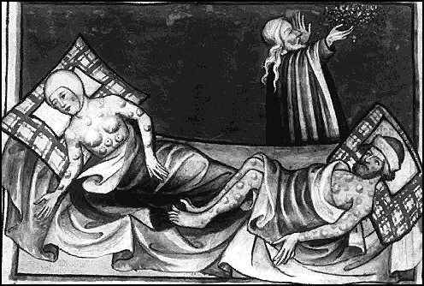
Effects of the Plague
Killed 25–30 million Europeans
Undermined faith in religion
Economy
Culture influenced
Notes:
The most obvious effect of the plague was the number of people it killed—an estimated 25 to 30 million Europeans, or roughly one-third of the population. The plague also shook many people’s faith in religion. Though many religious leaders blamed the plague on sin, piety and prayer offered no protection against the disease and members of the clergy were as likely to become afflicted as anyone else. In the face of all this, the numbers of those willing to devote their life to the church dramatically declined.
The population decrease caused by the plague led to an economic downturn; both the number of available laborers and consumers declined sharply. Merchants and tradespeople had fewer people to whom they could sell their wares. Products therefore accumulated, and the merchants and those who dealt with them—bankers, suppliers, and shippers—all lost revenue. In addition, peasants often left their land in an attempt to escape the disease.
The plague also influenced many of the artists of the time; works from this period often had very dark themes and tones.

Slide 69
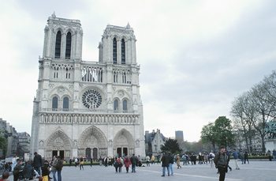
Architecture
Many churches and cathedrals built during the Middle Ages
Church designs
  Romanesque: cross, nave
  Gothic: ribbed vault, flying buttress, stained glass
Chartres Cathedral in France, a prime example of medieval Gothic architecture
Notes:
The Middle Ages saw a boom in the building of cathedrals and churches in Europe. By the 11th century, a clear but short-lived style of architecture emerged called “Romanesque” because it featured a Roman-like style inspired by Italian basilicas. This style produced an interior that was shaped like a Latin cross. From the exterior, a Romanesque church looked massive, with heavy, horizontal lines. The central area of the church (called the “nave”) was covered with a barrel vault, supported by pillars and thick walls. There were few windows; thus, the interior was gloomy.
A dramatic new style, known as Gothic, was introduced in the early 12th century. The architects of this style developed the “ribbed vault,” which worked like an umbrella to spread the weight of the roof from columns to the wall. To prevent the walls from collapsing, a structure called a “flying buttress” braced the tress from the outside. When combined with pointed arches, this meant a cathedral could have larger interior spaces and larger windows, allowing the building to be filled with light. Many of these cathedrals used stained glass to fill their windows, and the creation of stained glass evolved into a distinct art form.

Slide 70
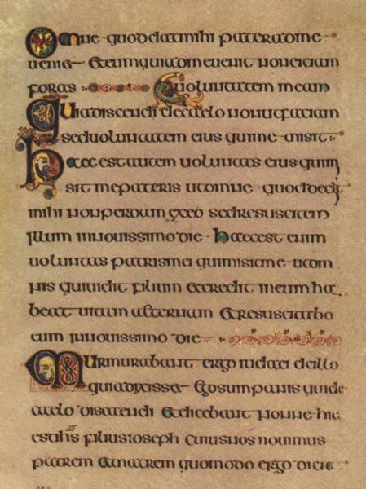
Illuminated Manuscripts
Manu scriptus
Scriptorium
Art form
Page from the Book of Kells, 800 CE, scribed by Celtic monks
Notes:
Prior to the invention of the printing press, all documents were manu scriptus, meaning “handwritten”; this Latin phrase is also the source of the English word “manuscript.” Most of the time, copied manuscripts were bibles or other religious works such as prayer books. The manuscripts were usually produced by monks who went about the laborious task of hand-copying books in a special room called a scriptorium. The monks would also illustrate the manuscripts, a process known as “illumination.” Monks would illuminate manuscripts both to glorify sacred texts and to help the illiterate understand what the book was discussing. After 1200, books became more common and professional scribes and illustrators began producing works. Often they were commissioned by the wealthy. The illumination of manuscripts became an art form. As well as illustrations appropriate to the story, verse, or prayer, capital letters at the beginning of each page were often decorated in bright colors and gold leaf.

Slide 71
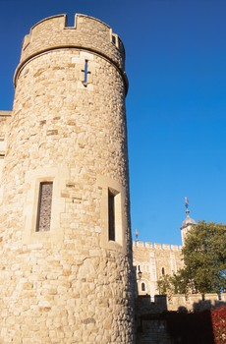
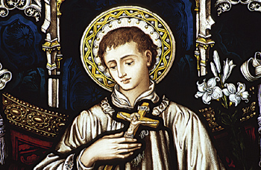
Legacy of the Medieval Era
Transitional period
New kingdoms evolved
The Church became a dominant force
Modern institutions originated
Notes:
The medieval era is considered a transitional period between the ancient classical world and the Renaissance. Immediately after the fall of Rome, Europe disintegrated into a number of small kingdoms and states. Throughout the period, however, new kingdoms gradually evolved into states—England, France, and Spain, for example.
The Catholic Church expanded its influence throughout western Europe, with little to challenge its dominance, although issues such as the Inquisition and the Crusades may have diminished its prestige.
Despite the popular view of medieval Europe as the “Dark Ages,” many modern institutions originated during this time, including universities, the parliamentary form of government, and banks. What historians often refer to as “modern Europe” was beginning to take shape by the end of the 15th century. The emergence of modern Europe would be shaped by other factors as well—the Renaissance, the Reformation, and global exploration over the next two centuries.

