Slide 1
Ch 6 Section 2 Notes

Slide 2
Another group of monks called the Franciscans was started by St. Francis of Assissi. They lived among the people, preaching repentance and aiding the people.
Another group the Dominicans wanted to defend the church from heresy - the denial of basic church doctrines. The became the examiners of people suspected of heresy.

Slide 3
The Inquisition was a court created by the Catholic Church to find a try heretics.
Heretics were people whose religious beliefs differed from the teachings of the Church.
The Christians of the thirteenth century believed the only path to salvation was through the Church. To them, heresy was a crime against God and against humanity. In their minds, using force (torture) to save souls from damnation was the right thing to do.

Slide 4
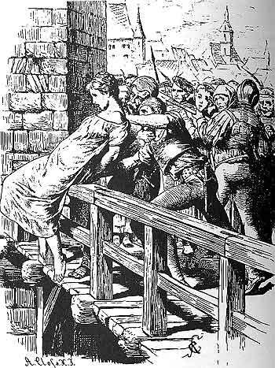
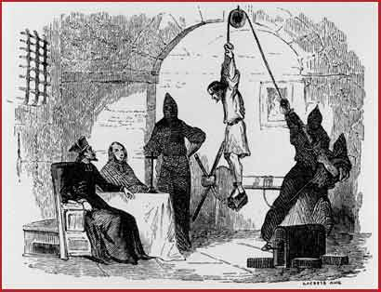

Slide 5
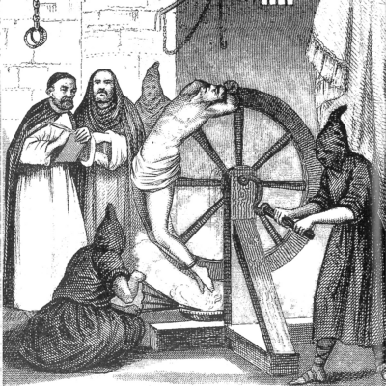

Slide 6
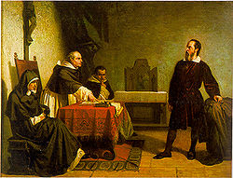
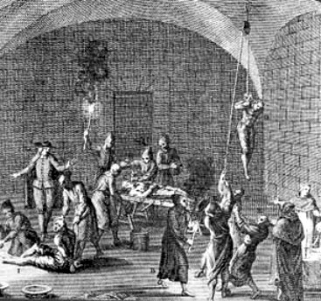

Slide 7
Only clergy could administer rites necessary for salvation. Saints were believed to be able to ask for favors before the throne of God for people who prayed to them. Relics=bones or objects connected to saints became very important. A connection between earthly world and God.
Christians believed that a pilgrimage to a holy shrine produced a spiritual benefit. Jerusalem or Rome.

Slide 8
White Board Challenge
1. What was the struggle between Henry the IV and Gregory VII known as?
2. What is the Lay Investiture?
3. What forbids priests from giving the sacraments to a certain group of people?
.

Slide 9
Crash Course Crusades 11.5 min
http://www.youtube.com/watch?v=X0zudTQelzI&list=PLKLr2j6n8lJMmWJI60M2OEdYqyudTzFUr&safe=active

Slide 10
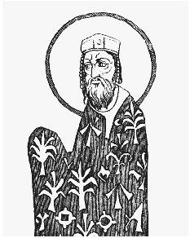
Byzantine emperor Alexius I, the man that started the crusades!
http://www.youtube.com/watch?v=SLidFSx47-o&safe=active
Watch first 1.5 min

Slide 11
The push for the Crusades came when, in 1093, the Byzantine emperor Alexius I asked for help. The emperor asked for help against the Muslim Turks.
Pope Urban II also read that letter. Shortly after this appeal, he issued a call for what her termed a "holy war," a Crusade to gain control of the Holy Land. Over the next 300 years, a number of such Crusades were launched.

Slide 12
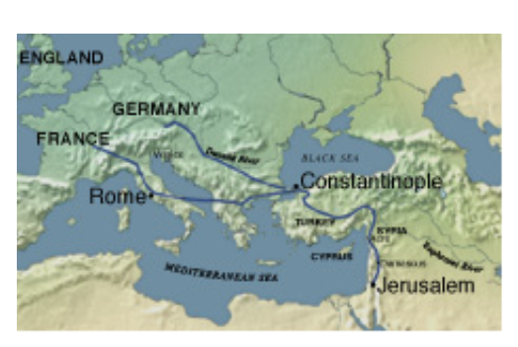
The Crusades had economic, social, and political goals as well as religious motives. Muslims controlled Palestine (the Holy Land) and threatened Constantinople.

Slide 13
The Crusades had economic, social, and political goals as well as religious motives. Muslims controlled Palestine (the Holy Land) and threatened Constantinople.
The Byzantine emperor in Constantinople appealed to Christians to stop Muslim attacks, to free Jerusalem from the infidels, the unbelievers. In addition, the pope wanted to reclaim Palestine and reunite Christendom, which had split into Eastern and Western branches in 1054.

Slide 14
Pope Urban's call brought a tremendous outpouring of religious feeling and support for the Crusade. According to the pope, those who died on Crusade were assured of a place in heaven. With red crosses sewn on tunics worn over their armor and the battle cry of "God wills it!" on their lips, knights and commoners were fired by religious zeal and became Crusaders. Pope promised “all who die shall have immediate forgiveness of sins”

Slide 15
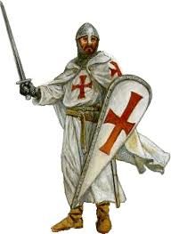

Slide 16
The Crusaders were ill-prepared for war in this First Crusade. Many know nothing about the geography, climate, or culture of the Holy Land. They had no grand strategy to capture Jerusalem.
The Crusaders besieged the city for over a month. On July 15, 1099, the Crusaders captured the city amid a horrible massacre of its inhabitants. (they killed Muslim and Jew-men, women and children)

Slide 17
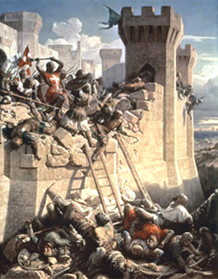

Slide 18
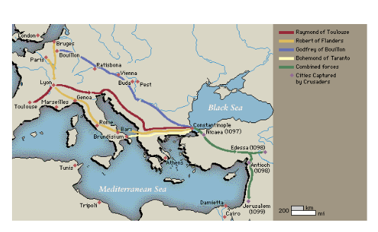
All in all, the Crusaders had won a narrow strip of land. It stretched about 650 miles from Edessa in the north to Jerusalem in the south.
The Crusaders' states were extremely vulnerable to Muslim counterattack. In 1144, Edessa was reconquered by the Turks.

Slide 19
White Board challenge Q?
Which Pope called for the first Crusade?

Slide 20
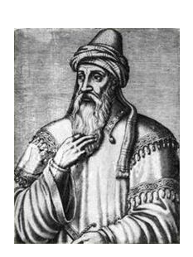
The Second Crusade
The Second Crusade was organized to recapture the city. But its armies straggled home in defeat. In 1187, Europeans were shocked to learn that Jerusalem itself had fallen to a Kurdish warrior and Muslim leader Saladin.

Slide 21
The Third Crusade
Third Crusade to recapture Jerusalem was led by three of Europe's most powerful monarchs
Phillip II (Augustus), of France
Frederick I (Barbossa), German emperor
Richard the Lion-Hearted, King of England

Slide 22
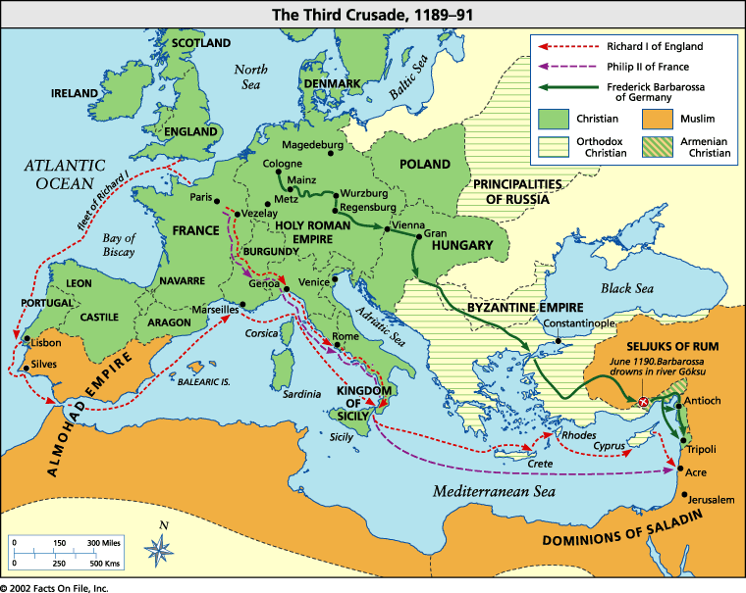

Slide 23
Phillip argued with Richard and went home. Barbossa drowned on the journey. So, Richard (the Lionhearted) was left to lead the Crusaders in an attempt to regain the Holy Land from Saladin.
Saladin led the Muslim forces during the Third Crusade to retake Jerusalem from the Crusaders.

Slide 24
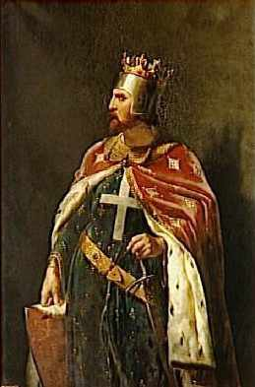
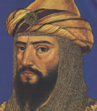
Saladin
Richard the Lion-Hearted, King of England

Slide 25
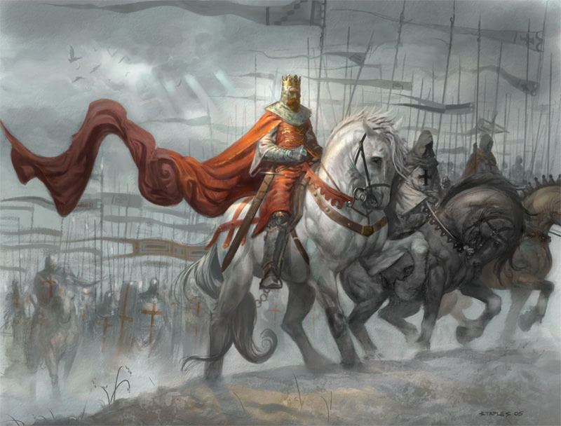

Slide 26
Both Richard and Saladin were brilliant warriors. After many battles, the two agreed to a truce in 1192. Jerusalem remained under Muslim control. In return, Saladin promised that unarmed Christian pilgrims could freely visit the city's holy places.
Remember 1st Crusade massacre? So, this was more than fair.

Slide 27
The Fourth Crusade
In 1204, the Fourth Crusade to capture Jerusalem failed. The knights did not reach the Holy Land. Instead, they ended up looting the city of Constantinople. This added to the division between the Eastern Orthodox Church and the Catholic Church.

Slide 28
In the 1200's, four more Crusades to free the holy land were also unsuccessful. The religious spirit of the First Crusade faded and the search for personal gain grew, $$$$.
In two later Crusades, armies marched not to the Holy Land but to Egypt. The Crusaders intended to weaken Muslim forces before going to the Holy Land. But none of these attempts conquered much land.

Slide 29
The Children's Crusade
The Children's Crusade took place in 1212. Thousands of children set out to conquer Jerusalem. One group in France was led by 12-year-old Stephen of Cloyes. An estimated 30,000 children under 18 joined him. They were armed only with the belief that God would give them Jerusalem. On their march south to the Mediterranean, many died from cold and starvation. The rest drowned at sea or were sold into slavery.

Slide 30
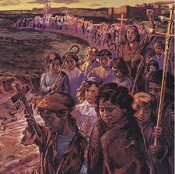
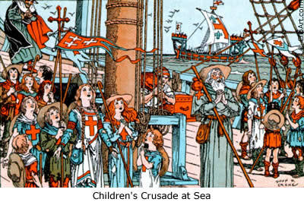
Really!
http://www.youtube.com/watch?v=V8PPe8snkmA&safe=active
5 min horrible histories

Slide 31
Impact of Crusades:
Italian port cities prospered,
Jews became subject to persecution,
the breakdown of feudalism.
Nobles sold land and freed their serfs to join crusades.
Nobles lost power-king created stronger central governments.
3 nations emerge-Spain, England and France.

Slide 32
WHITE BOARD CHALLENGE
1. When did the push for the Crusades come?
2. Who led the Muslim forces during the Third Crusade to retake Jerusalem form the crusaders?

