Slide 2
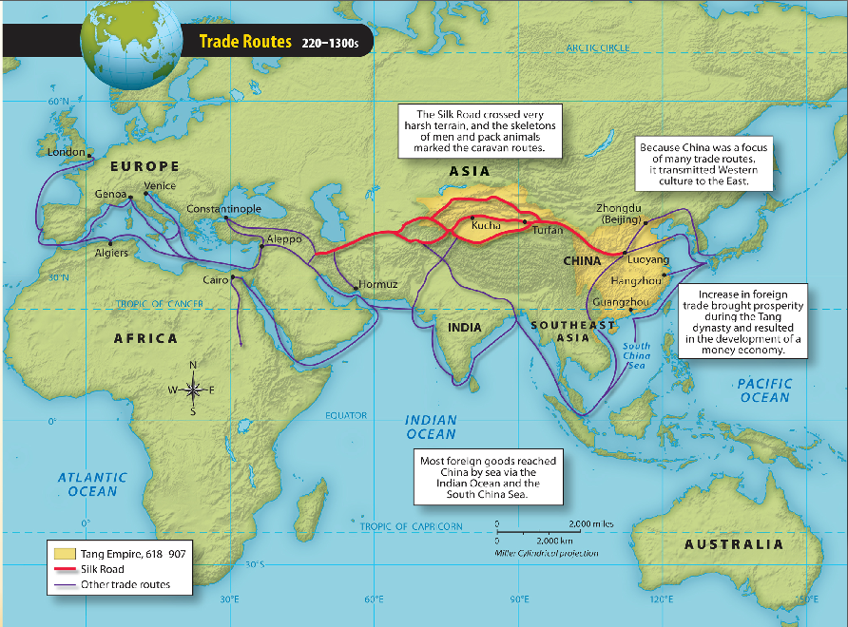
East Asia 200-1300s

Slide 3
Lesson Summary
Han Dynasty ends in 220, chaos ensues
300 years later Sui Dynasty emerges
Grand Canal-that’s about all they’re remembered for
Tang Dynasty pops up 40 yrs later
Land reforms, civil service exams are back
Expand power
Song Dynasty comes much later
Cultural flourishing, then Mongol invasion

Slide 6
Unification Under Sui
Sui Dynasty (581-618)
Re-Unification after 300 years of chaos
Grand Canal
Emperor Sui Yangdi completed GC, linking the Yellow and Yangtze rivers
Good for trade between N. and S. China
Ultimately leads to Sui downfall
Forced labor, high taxes, and extravagance at court angers everyone

Slide 7
Tang Reforms
Tang Dynasty (618-907)
Land Reform: redistribute land to peasants
Gov’t. Reform: reinstituted civil service exams, based on Confucius’ teachings
Restored China’s Influence
Peace in NW China and control of Tibet.
Diplomatic relations with SE Asia
Collapse
Corruption and rebellions (nepotism)

Slide 8
https://www.youtube.com/watch?v=vfe-eNq-Qyg
Crash course Silk Road

Slide 9
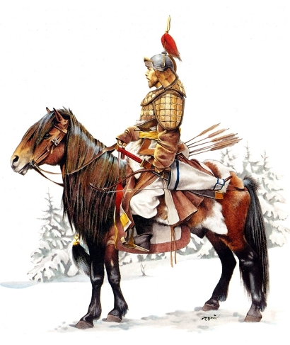
Prosperity Under Song
Song Dynasty (960-1279)
Prosperous and cultural growth
Invasions from North!
Mongols eventually overwhelm in the late 1200s and control China shortly thereafter

Slide 10
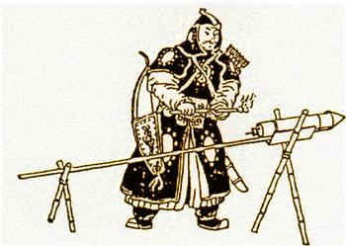
Three Dynasties = Sui, Tang & Song
Trade flourished and guilds grew
Banking and a money economy developed
Gunpowder invented and primitive flame-thrower used in battle: the fire lance!

Slide 12
Gov’t. & Economy During Three Dynasties
Mature political/economic system is born!
Monarchy and merit-based system
Civil service exams create some social mobility and a literate bureaucracy
Farming:
Improved techniques and land reform produced more food

Slide 13
Think Pair White Board Challenge
Why were the landed gentry that replaced the old aristocracy known as scholar-gentry?
merit-based system
Civil service exams create some social mobility and a literate bureaucracy

Slide 14
Gov’t. & Economy, Cont’d.
Steel, cotton and gunpowder
All invented/discovered…better weapons, clothes
Private merchants and guilds
Before Chinese gov’t. mostly controlled trade
Silk Road comes back b/c of Arab stability
Money
In the 700-800s paper money as currency started to replace copper coins, banking blossomed

Slide 16
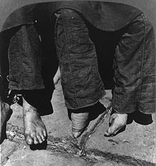
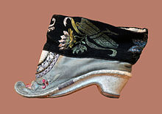
Chinese Society
Three Dynasties were an age of relative prosperity
Gap between rich and poor narrowed
BUT women still had very little power or influence during this time.
Foot binding probably started in the Song Dynasty

Slide 19
Lesson Summary
Han ends in 220, chaos ensues
300 years later Sui Dynasty emerges
Grand Canal
Tang Dynasty pops up 40 yrs later
Land reforms, civil service exams are back
Expand power
Song Dynasty comes much later
Cultural flourishing, then Mongol invasion

Slide 20
Ch 5.1 White Board Challenge
What traditional ideals underlined Chinese gov’t. during the Three Dynasties?
How did the Tang Dynasty improve farming and food production?
What is the name for the major trade artery that winds through Asia to Europe?

Slide 21
Ch 5.1 White Board Challenge
What traditional ideals underlined Chinese gov’t. during the Three Dynasties?
Confucian
How did the Tang Dynasty improve farming and food production?
Land reform and new technology
What is the name for the major trade artery that winds through Asia to Europe?
Silk Road

Slide 22
Mongols and Chinese Culture
Ch 5.2, p. 87

Slide 26
Ch 5.2 Vocab
Khanate
Neo-Confucianism
Porcelain

Slide 28
Mongol Empire
Origins
Nomads from northern Asia, raised livestock and travelled by horseback
Genghis Khan
Unifies Mongols in early 1200s and conquers largest land empire of all time
After death divides empire into 4 Khanates

Slide 29
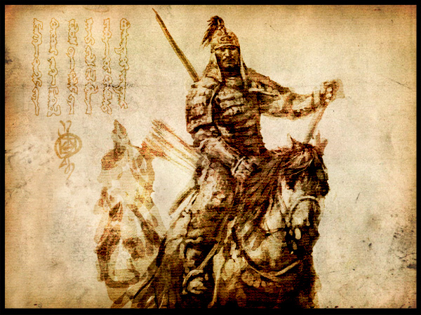
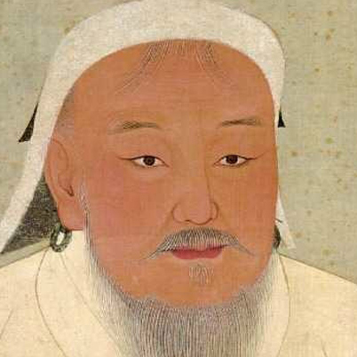
Temujin, aka Genghis Khan

Slide 30
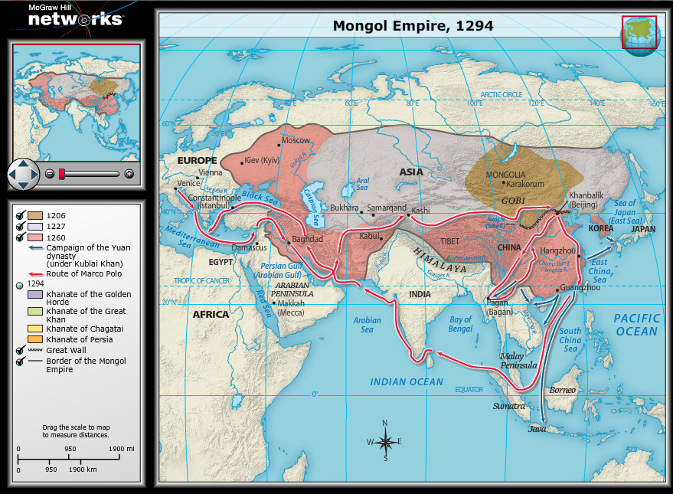

Slide 31
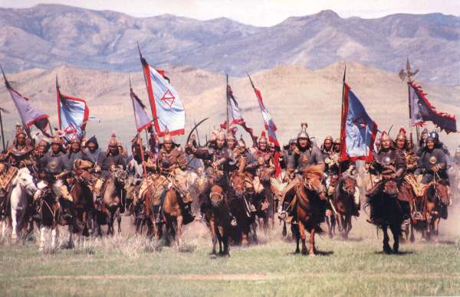
https://www.youtube.com/watch?v=szxPar0BcMo Crash course-Mongols

Slide 32
Kublai Khan
Grandson of Genghis
Completes conquest of China, creates Yuan Dynasty in 1279
Rules from capital called Khanbalik
Adopts and modifies current political system
Eventually, the locals love Kublai Khan
BUT fails to capture Japan and Indonesia
Bad weather…TSUNAMI!

Slide 33
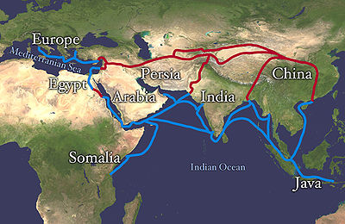
The Growth of Trade
Mongols brought all of Eurasian land mass under unified rule
LARGEST land empire, ever…
Lots of trade and reinvigoration of Silk Road

Slide 34
Mongol Religion & Gov’t.
Buddhism and Daoism
From India to China in 1st Century
Imperial court gets upset b/c of land and serfs
Tang Dynasty destroys temples and makes followers “get back to work”
Confucianism → Neo-Confucianism
Song Dynasty modernizes ideals to include societal benefits
Fulfillment comes from participation in material world

Slide 36
Golden Age
Cultural Advancements from Tang and Yuan
Printing invented in movable type
Famous poetry
Li Bo and Du Fu
Daoist painting
Landscape art from Song and Yuan dynasties, nature
Porcelain unrivaled, even today (Tang)

Slide 37
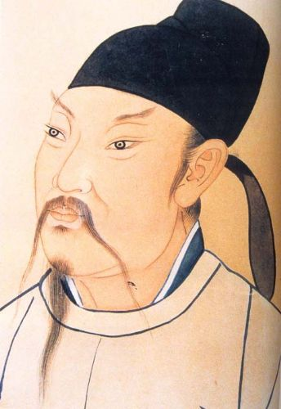
Li Bo

Slide 38
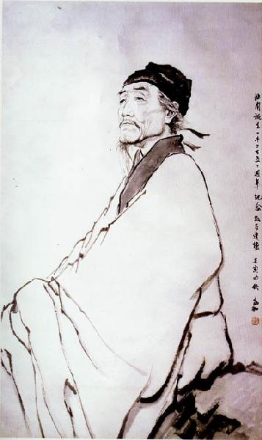
Du Fu
beard, but who’d have the heart to scold them?

Slide 39
Ch 5.2 White Board Challenge
T/F: Neo-Confucianism did not address ideas tackled by Buddhism and Daoism.
Who led the Yuan Dynasty
Cultural advances occurred most in which dynasty: Song, Tang, or Yuan?

Slide 40
Ch 5.2 Discussion & Review
T/F: Neo-Confucianism did not address ideas tackled by Buddhism and Daoism.
False, material wealth
Who led the Yuan Dynasty?
Kublai Khan
Cultural advances occurred most in which dynasty: Song, Tang, or Yuan?
Tang

