Slide 2
The Byzantine Empire and Emerging Europe
Ch 2.1 The First Christians
Crash course-Christianity

Slide 3
CHARLEMAGNE
What symbols of Charlemagne’s secular power appear in the stained glass?
2. What might you infer about Charlemagne from the fact that his image appears on a stained glass window in a cathedral?

Slide 4
CHARLEMAGNE
What symbols of Charlemagne’s secular power appear in the stained glass? The crown, orb, and scepter all symbolize Charlemagne’s secular power.
2. What might you infer about Charlemagne from the fact that his image appears on a stained glass window in a cathedral? Charlemagne was highly respected as a good Christian or that the Church sanctioned his power.

Slide 5
Place & Time
50 – 800 AD
The Roman government began persecuting (harassing to cause suffering) Christians during the reign of Nero (a.d. 54–68).
The occasional persecution of Christians by the Romans in the first and second centuries had not stopped the growth of Christianity. It strengthened Christianity in the second and third centuries by forcing it to become more organized. Missionaries used the Roman language and organizational structures to spread their message.

Slide 6
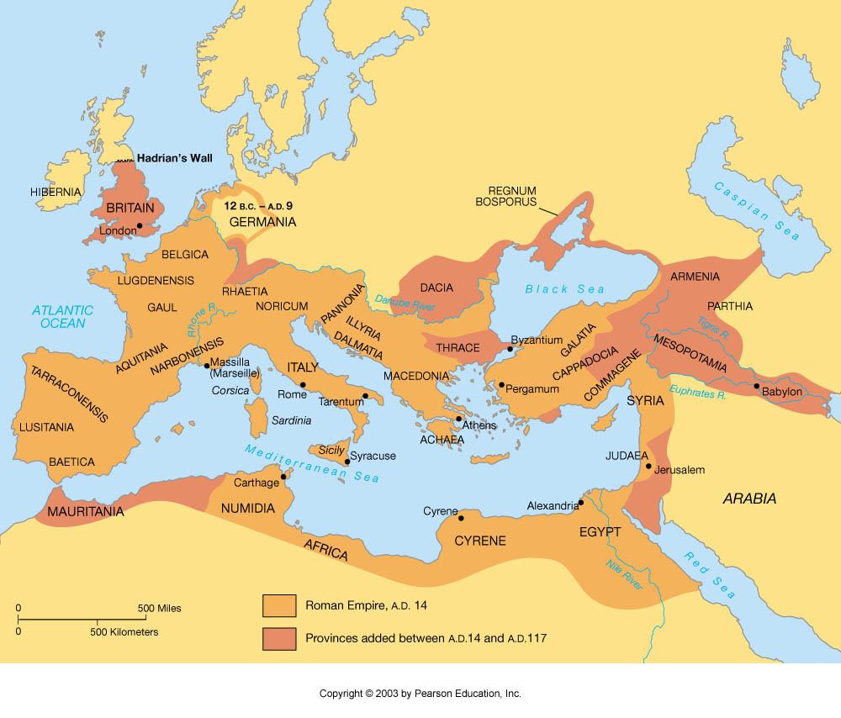
The Roman Empire

Slide 7
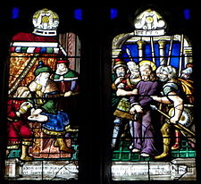
Judaism in the Roman Empire
6 AD, Judaism in Rome
Different groups
Sadducees: cooperative with Roman empire
Pharisees: sought to avoid Roman influence
Essenes: hermits, waited for God
Zealots: into violent overthrow
Pontius Pilate
Governor of Judaea (AD 26-36)

Slide 8
Rise of Christianity
Christianity blooms
Why was Christianity able to attract and maintain so many followers?
1- Christianity was personal and offered salvation and eternal life to individuals. Christianity gave life a meaning and purpose unlike Roman culture.
2- Jesus had been a human figure to whom it was easy to relate. Moreover, Christianity did not require painful or expensive initiation rites .
3- Finally, Christianity fulfilled the human need to belong. Christianity satisfied the need to belong in a way that the huge Roman Empire could never provide.
Viking Stone, emphasizing Christianity far from home

Slide 9
Key concepts expressed by Jesus shaped the value system of Western civilization:
Humility
Charity
Love towards others

Slide 10
Spread of Christianity
Early apostles of Christianity
Peter-leader of apostles
Paul-took message to Gentiles (non-Jews)
Epistles (written accounts) → eventually become Gospels
Establishment of churches
Change in Roman attitudes
Christianity suddenly viewed as harmful to public order/morals
Refused to worship Roman gods/goddesses

Slide 11
Christianity, cont’d.
Christianity becomes organized!
Starting using Roman language and structure to pass messages
Constantine (Emperor of Rome) and the Edict of Milan-
313, official tolerance-it was adopted as the religion of Rome
Christianity accepted in the Roman Empire
Becomes official religion in late 4th century

Slide 12
Spread of Christendom Cont’d.

Slide 13
Religions of Today

Slide 15
Discussion & Review
Which group of violent Jews called for the overthrow of Roman rule?
Zealots
Which Roman official ordered the execution of Jesus?
Pontius Pilate
What is the vocab term for a Roman official in charge of a province?
Procurator

Slide 16
Stuff to Chew On
What are the beliefs that define Christianity?
How did Christianity spread through the Roman empire?
How do you think the division of the Christian church into clergy and laity helped spread Christian beliefs?

